Slide 1
Continuous Control M. Hamza Javed
Scalable trust-region method for deep reinforcement learning using Kronecker-factored approximation
Yuhuai Wu, Elman Mansimov, Shun Liao, Roger Grosse, Jimmy Ba.
Proximal Policy Optimization Algorithms:
John Schulman, Filip Wolski, Prafulla Dhariwal, Alec Radford, Oleg Klimov.

Slide 2
Gradient Ascent:
1st order >> Bounce around high curvature

Slide 3
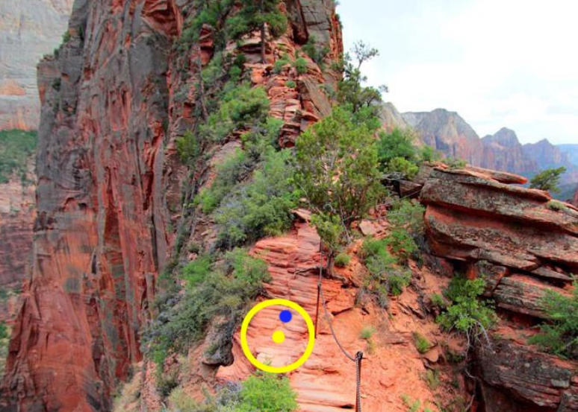
Natural Gradient:
Objective Function
Norm scaled by F > fisher information matrix
F = Identity
for Eu norm.

Slide 4
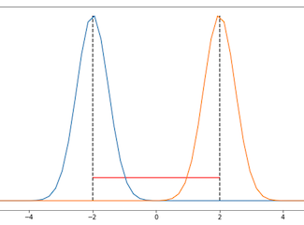
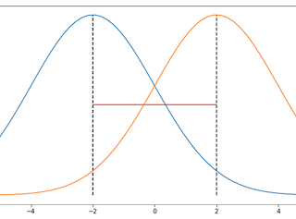
Natural Gradient for policy optimization:
Dependence upon parametrization?
∆θ ?
Probabilistic
metric ?
KL divergence

Slide 5
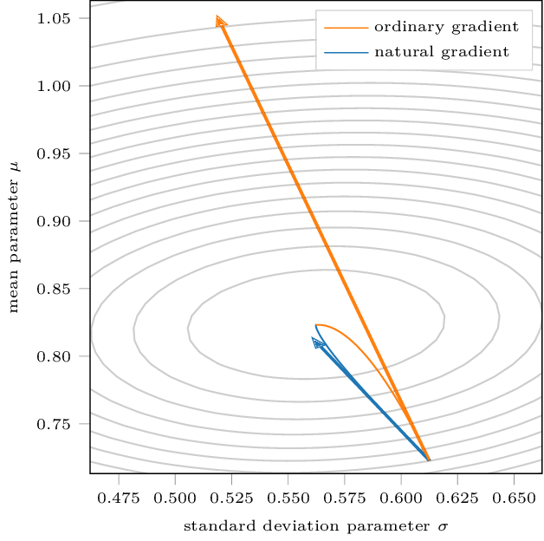
Trust region methods:
KL divergence independent parameterization

Slide 6
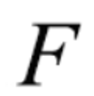
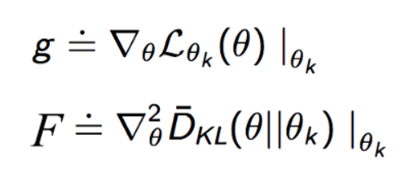
Trust region methods:
Approximations
First order gradient
Fisher matrix
θ And θ_{k} >> close to each other

Slide 7
Updated Model:
Natural gradient update:

Slide 8
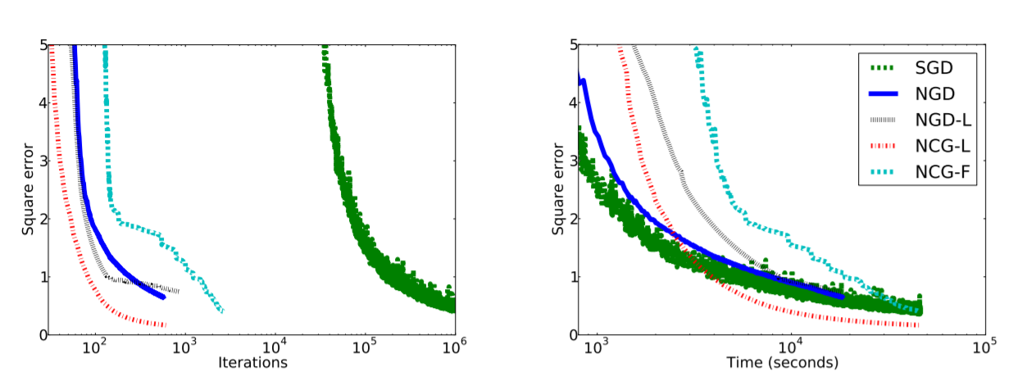
Challenges with policy gradient:
Sample efficiency Gradient descent.
Using natural gradient (2nd order)

Slide 9
TRPO challenges: (Trust region Policy Optimization)
TRPO
Natural Gradient Algorithm
Better sample efficiency
Computationally expensive
Second degree Approximation of Fisher Matrix
Reason: Inverting the Fisher Matrix
Conjugate Gradient Algorithm (Need a lot of samples)
Ultimately: Impractical for large networks and suffers from sample inefficiency

Slide 10
ACKTR: (Actor Critic using Kronecker-Factored Trust Region)
ACKTR uses Kronecker factor approximation to Fisher matrix.
10-25% computational power
Advantage Function (k-step return)

Slide 11
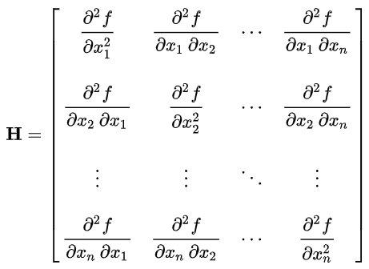
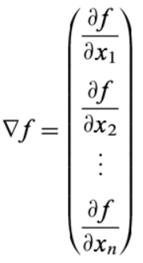
Fisher Matrix:

Slide 12
Kronecker product
Increases the size of the matrix
A ^{(m x n)} , B ^{(p x q)} then A⊗B ^{(mp x nq)}

Slide 13
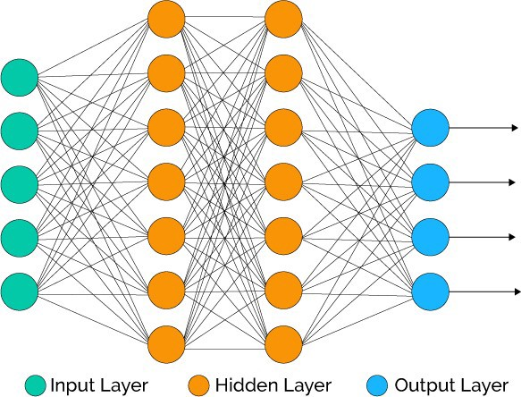
K-FAC:
L = log p(y|x) log likelihood.
W ∈ R^{Cout×Cin} , Weights of layer ℓ^{th}.
A = input activation.
S = pre-activation of next layer.
s = Wa >>>>> ∇_{W}L = (∇_{s}L)a⊺
Update layer by layer
Kronecker product

Slide 14
K-FAC:
Does not blow up dimensionality
Basic identities.
We have
Important assumption?
Notes:
second-order statistics of the activations and the backpropagated derivatives are uncorrelated.

Slide 15
ACKTR:
Apply KFAC to critic
Issue?
= 1

Slide 16
ACKTR :
TRPO:
fisher vector products > Scaling issues.
Sample efficiency.
Better /iteration efficiency.
ACKTR:
Fisher Approximation
Inversion of low dimension.
10-25% computational cost increase.

Slide 17
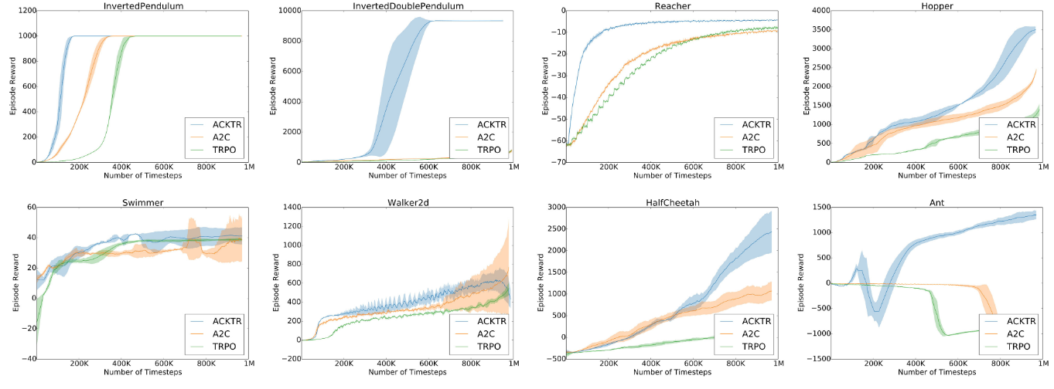
ACKTR :
Continuous control:
Discrete control:
On par with Q-learning techniques (36/44 benchmarks).

Slide 18
ACKTR :

Slide 19
Conclusion:
TRPO and ACKTR are complex.
A simpler method perhaps?

Slide 20
PPO: (Proximal Policy Algorithms)
Use a first order method to replicate the goal of TRPO.

Slide 21
PPO: (Proximal Policy Algorithms)
Policy Gradient methods:
Trust Region Methods:

Slide 22
PPO: (Proximal Policy Algorithms)
Trust region methods (Theoretically):
β >> !!!

Slide 23
Adaptive KL coefficient:
target kl divergence = d_{targ}.

Slide 24
PPO: (Proximal Policy Algorithms)
Surrogate objective:
Main objective:

Slide 25
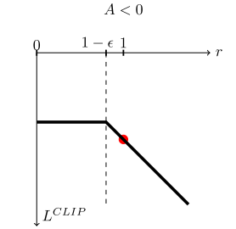
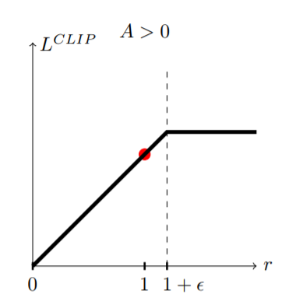
PPO: (Proximal Policy Algorithms)
Main objective:
R>1
R<1
R>1

Slide 26
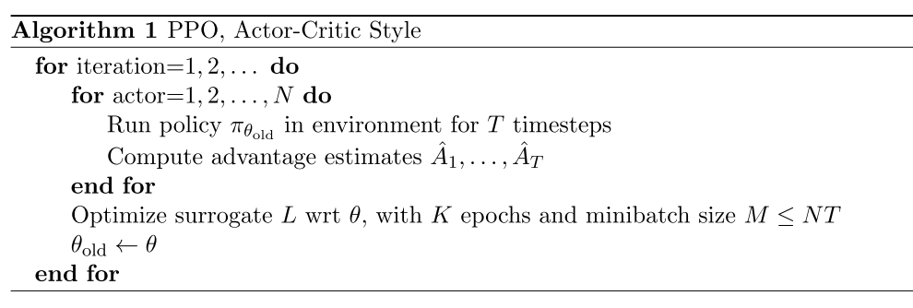
Algorithm:

Slide 27
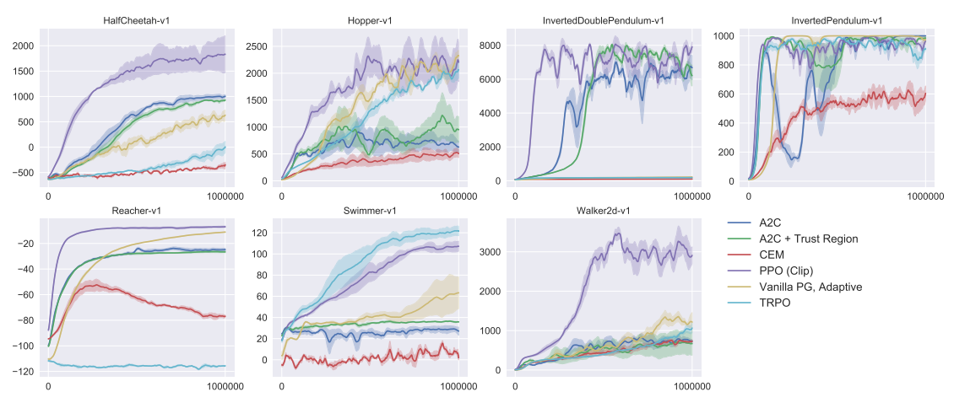
Results:

Slide 28
Video: Humanoid Running and Steering

Slide 29
Video: Emergence of Locomotion Behaviours in Rich Environments DPPO

Slide 30
Questions?
References:
J. Schulman, S. Levine, P. Moritz, M. I. Jordan, and P. Abbeel. “Trust region policy optimization”. In: CoRR, abs/1502.05477 (2015).
Schulman, John, et al. "Proximal policy optimization algorithms." arXiv preprint arXiv:1707.06347 (2017).
Martens, James. “New insights and perspectives on the natural gradient method.” arXiv preprint arXiv:1412.1193 (2014).
Ly, Alexander, et al. “A tutorial on Fisher information.” Journal of Mathematical Psychology 80 (2017).
ascanu, Razvan, and Yoshua Bengio. “Revisiting natural gradient for deep networks.” arXiv preprint arXiv:1301.3584 (2013).
Kingma, Diederik P., and Jimmy Ba. “Adam: A method for stochastic optimization.” arXiv preprint arXiv:1412.6980 (2014).
Salimbeni, Hugh & Eleftheriadis, Stefanos & Hensman, James. (2018). Natural Gradients in Practice: Non-Conjugate Variational Inference in Gaussian Process Models.
arXiv:1301.3584v7
Jonathon Hui – Series of RL – medium
Scalable Trust-Region Method for Deep Reinforcement Learning Using Kronecker-Factored Approximation. Microsoft Research talks by Yuhuai Wu.

