Slide 1
Crucial Component: Activation Function
Determines output and performance of network
They are all non-linear, differentiable
Binary Classification
Output between 0-1
No negative values
Efficient computation

Slide 2
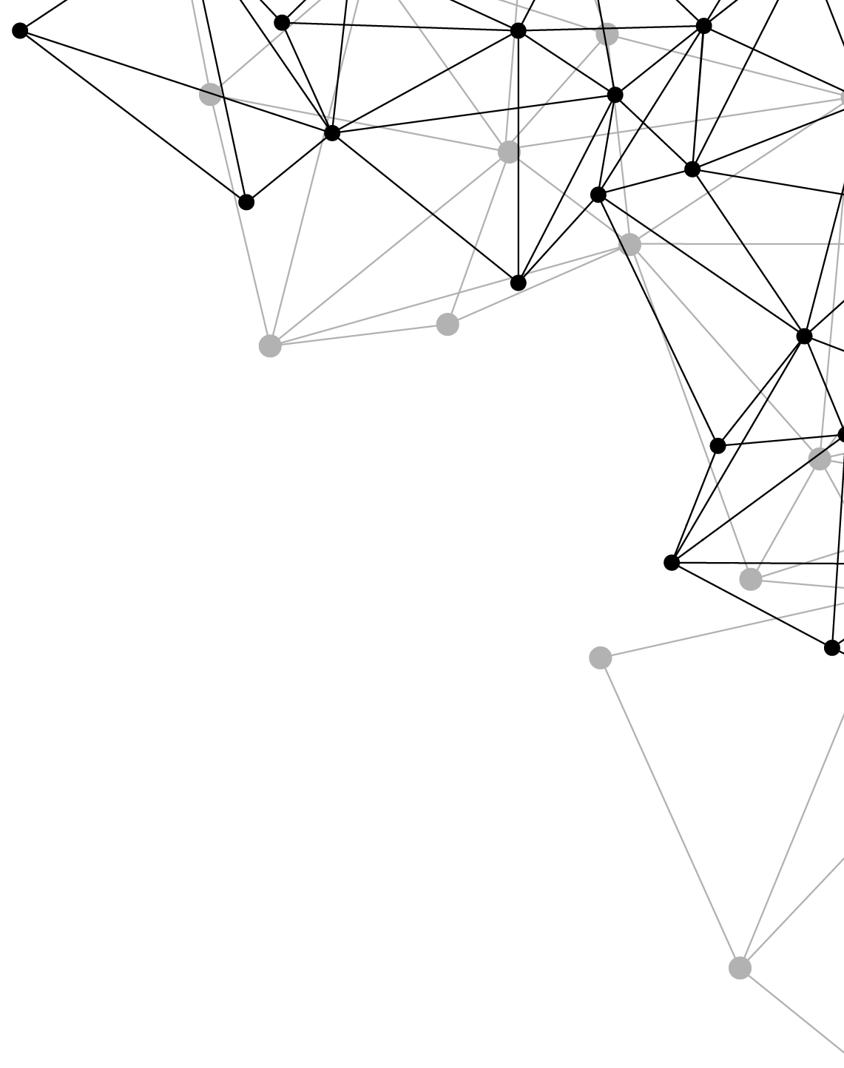
Introduction to Deep Learning
Seminar in Deep Neural Networks
Jonas Bokstaller
02.03.2021

Slide 3
Deep learning is a subset of ML/AI

Slide 4
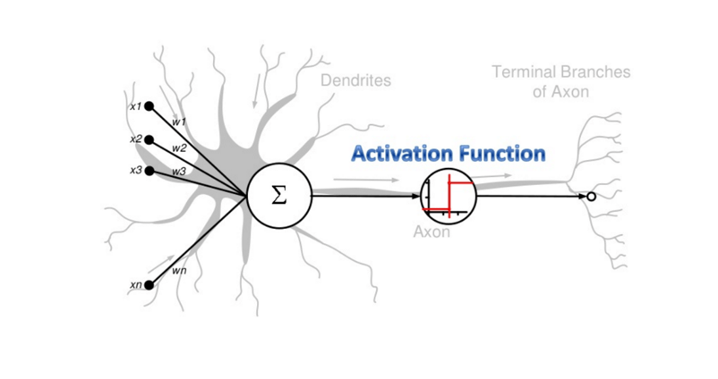
Basic Building Block: Neuron

Slide 5
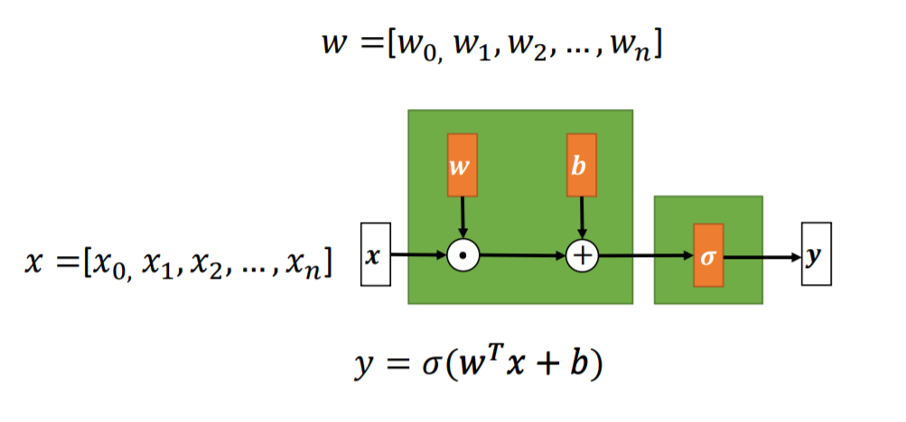
Basic Building Block: Neuron
Weights : Control strength of signal between neurons
Bias : Offset weight value
Activation function : Calculates output with nonlinear function

Slide 6
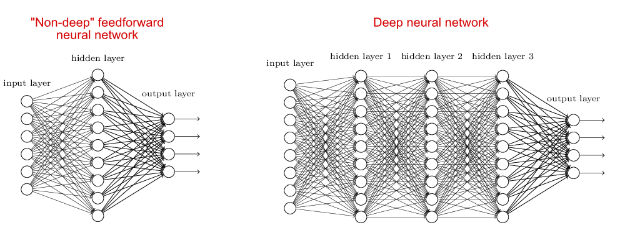
Neural Networks: combination of Neurons

Slide 7
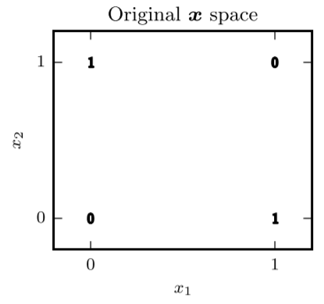
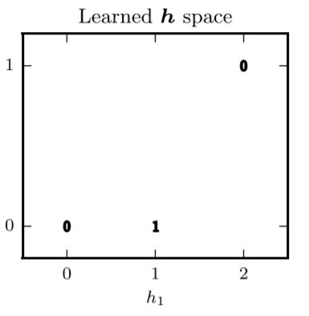
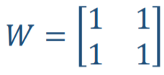
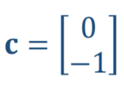
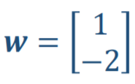
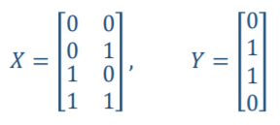
Activation Function: linear vs. non-linear
Linear function: output is a linear transformation of input
Example: XOR
Non-linear activation function
Transformation of
Input space

Slide 8
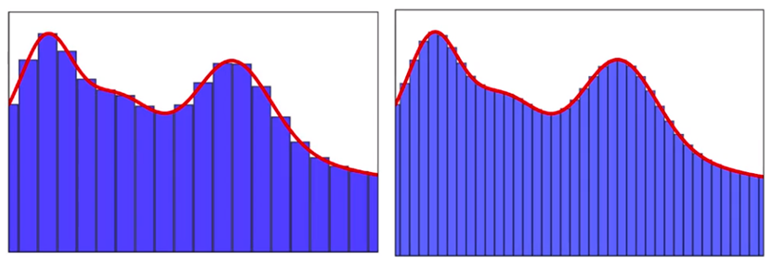
Universal Approximation Theorem
„A feed-forward neural network with a single hidden layer and continuous non-linear activation function can approximate any continuous function with arbitrary precision“
Neural Network
One hidden layer
Non-linear activation function
Deep Neural Networks >_{in practice} Wide Neural Networks
Approximate any function with any precision

Slide 9
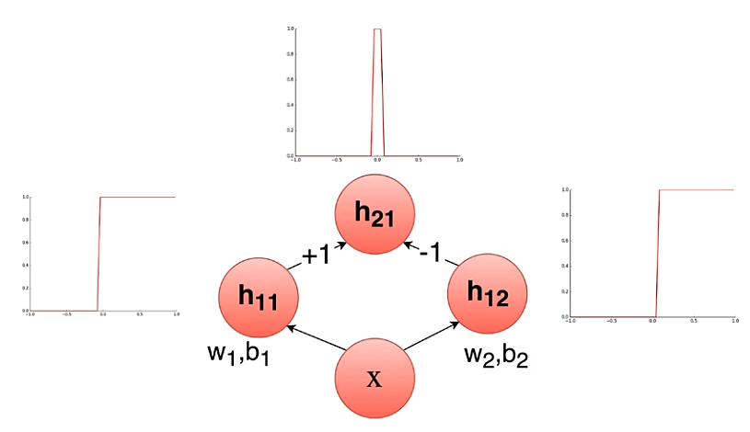
Universal Approximation Theorem
2x Step function = Bump function
ReLu Activation function

Slide 10
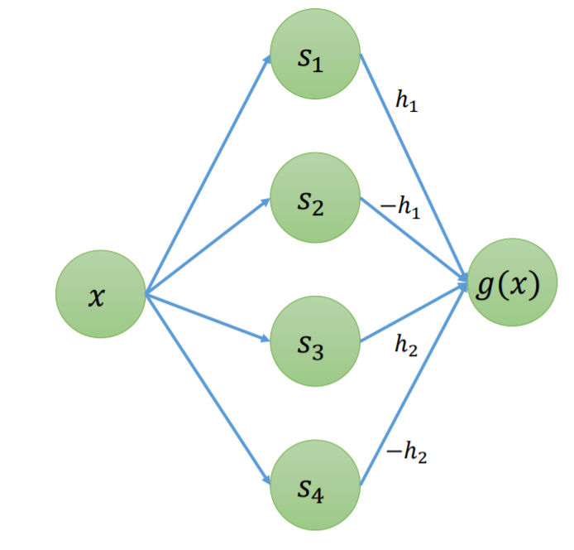
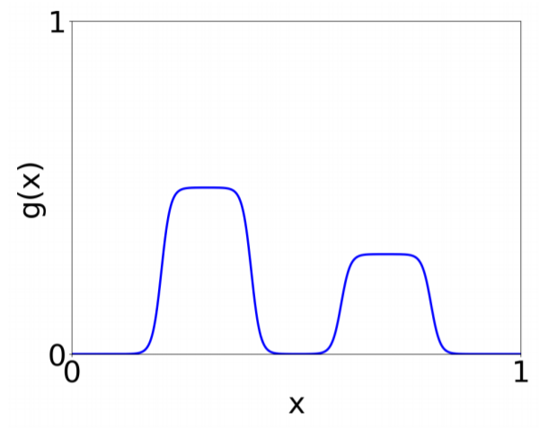
Universal Approximation Theorem
1 Step function
=
2 Neurons

Slide 11
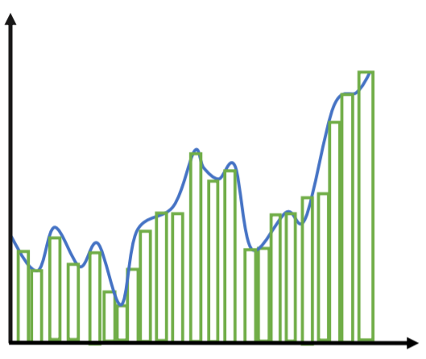
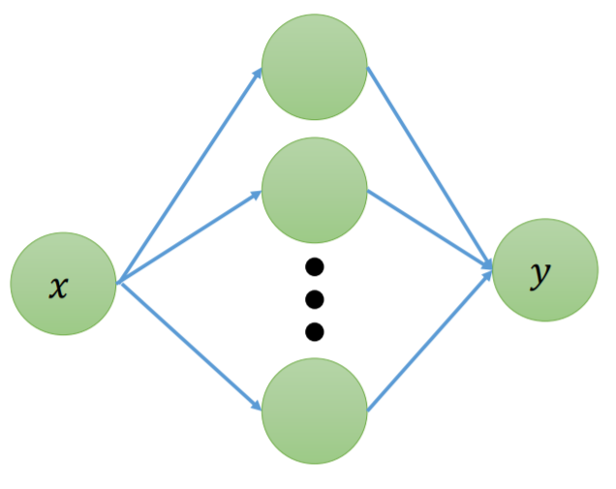
Universal Approximation Theorem
n Step function
=
2n Neurons
No guarantee to learn the right parameters

Slide 12
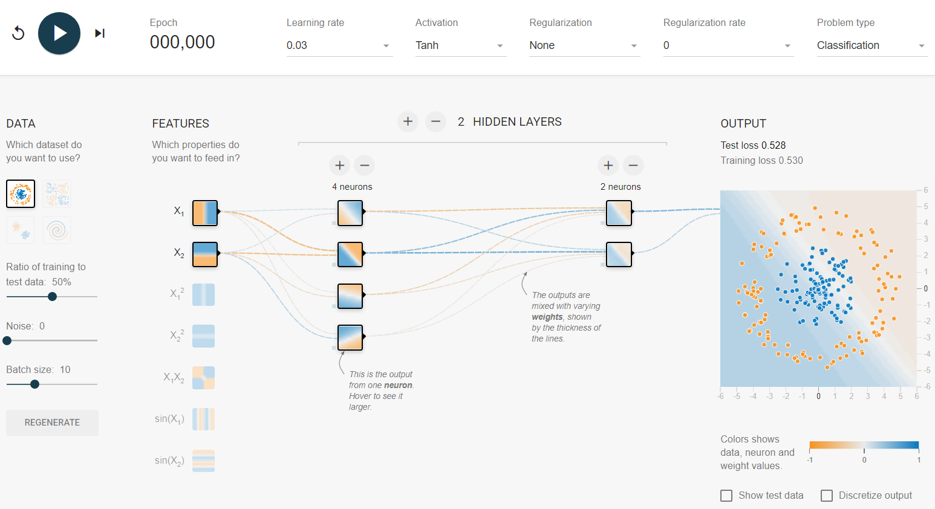
Demo: Neural Network in action
Visualization of trained model
Single Neuron
Dataset(x,y)
Hidden Layers
Input Layer
Output Layer

Slide 13
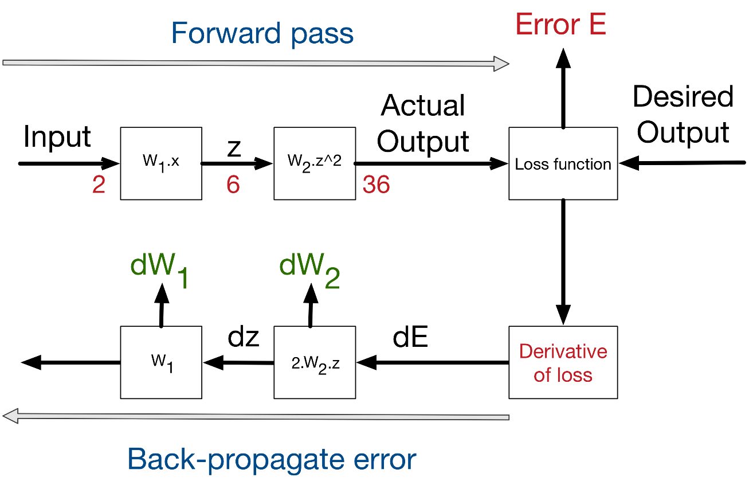
Training Neural Networks
1. Forward pass: compute output based on input of training data
2. Backward pass: Adjust weights/biases to reduce loss

Slide 14
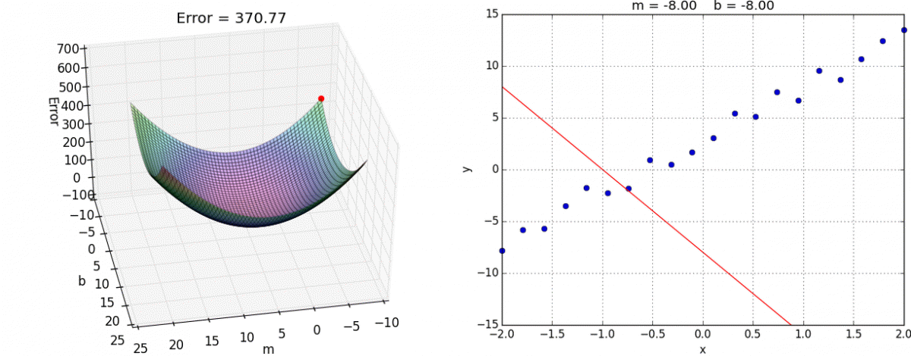
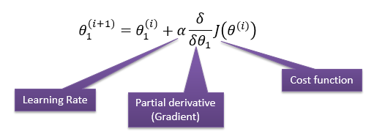
Gradient Descent: minimizing the loss
Do this for every weight/bias

Slide 15
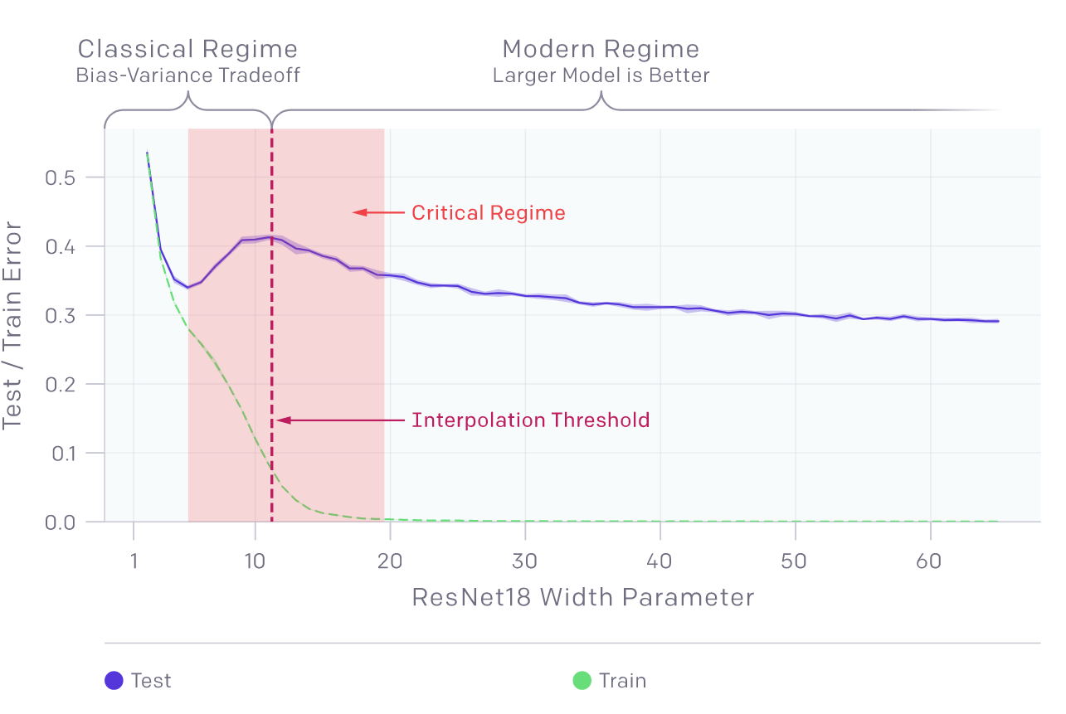
Deep Double Descent
Phenomena in modern deep learning
Performance improves, gets worse and improves again by adding more complexity, data or training time
Can be avoided by regularization
Can’t be explained at the moment

Slide 16
DDD: bigger models are sometimes worse
More complex model
performs worse
Model is just large
enough to fit training data

Slide 17
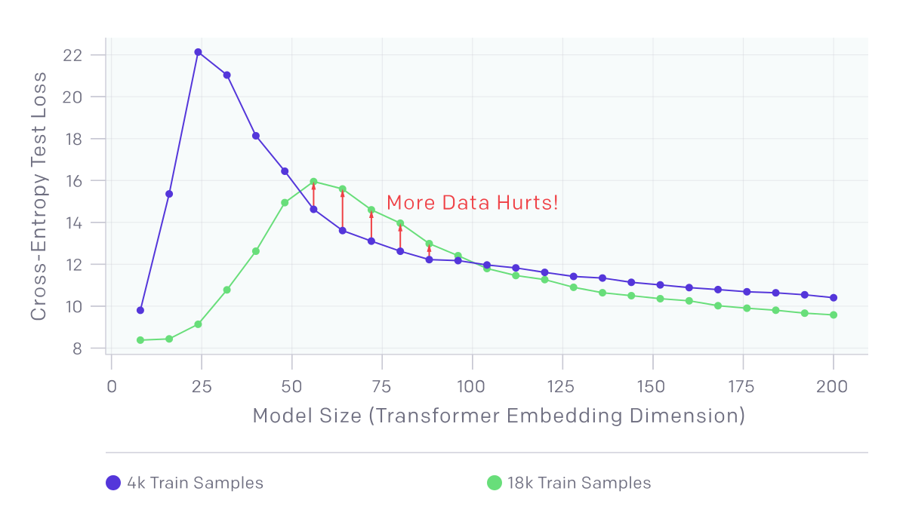
DDD: more data is sometimes worse
Once model is
Complex enough,
more data is again
better
Less complicated models cannot capture
all data → worse generalisation

Slide 18
DDD: training longer undoes overfitting
Test Error is getting
better once again
Test Error is getting worse (overfitting)

Slide 19
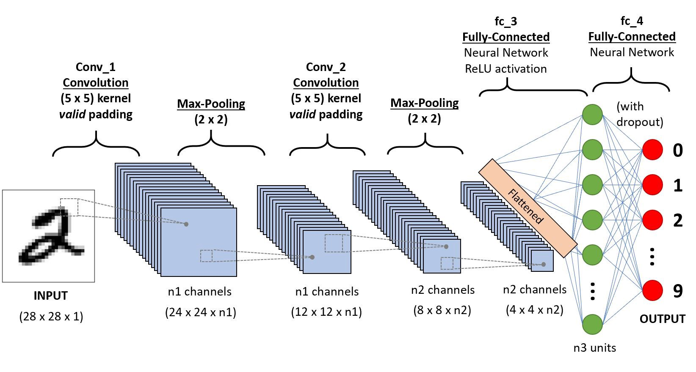
Convolutional Neural Networks

Slide 20
Convolution: Intuition
Vertical Edge detection

Slide 21
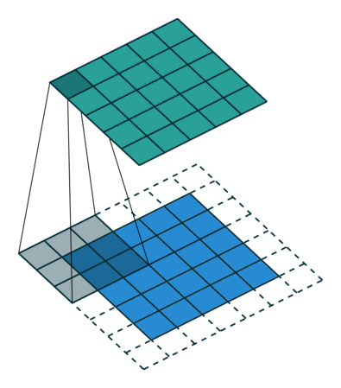
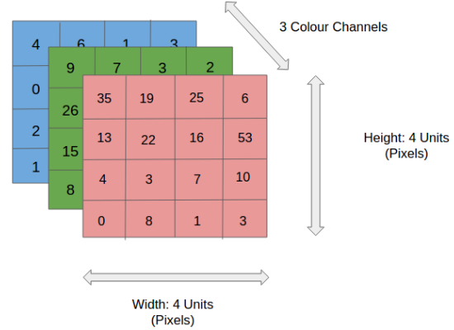
Convolution: Intuition
Kernel Size: 3x3x1
Stride: 1
Zero-Padding

Slide 22
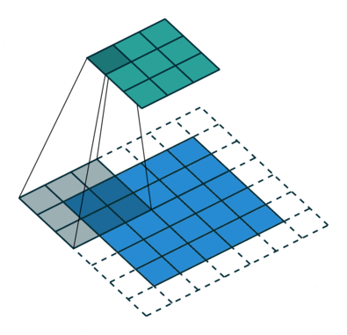
Convolution: Intuition
Kernel Size: 3x3x1
Stride: 2
Zero-Padding

Slide 23
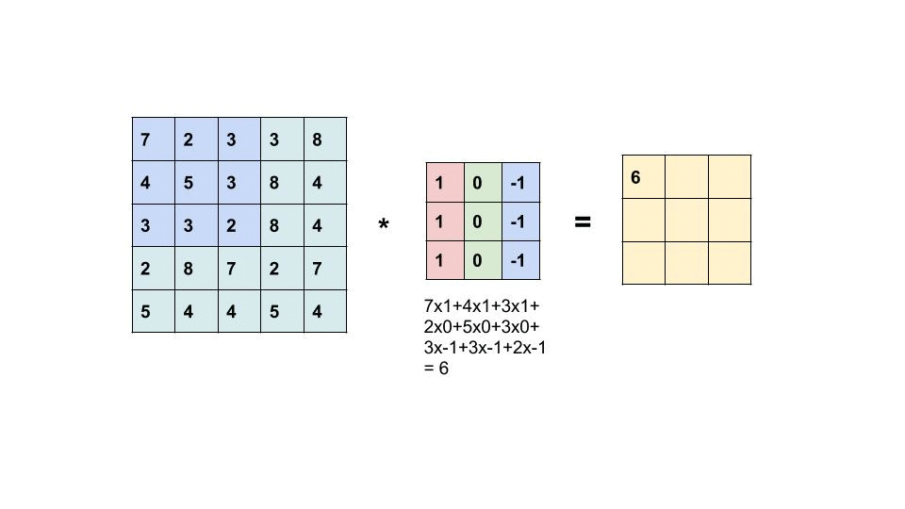
Convolution: Math
Filters capture spatial/temporal dependencies
Reduces dimensionality → Faster

Slide 24
Convolution: Math
BUT: Filter weights need to be learned

Slide 25
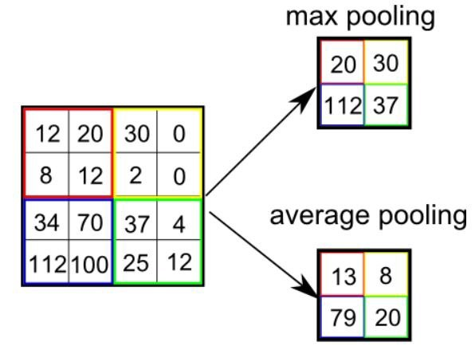
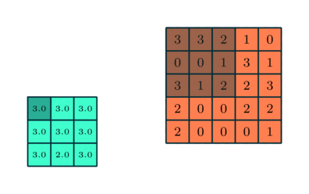
Pooling
Reduce Image Size
Max/Min/Average Pooling

Slide 26
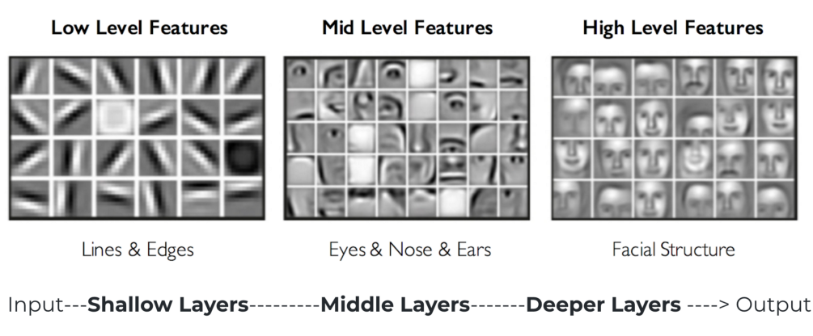

Slide 27
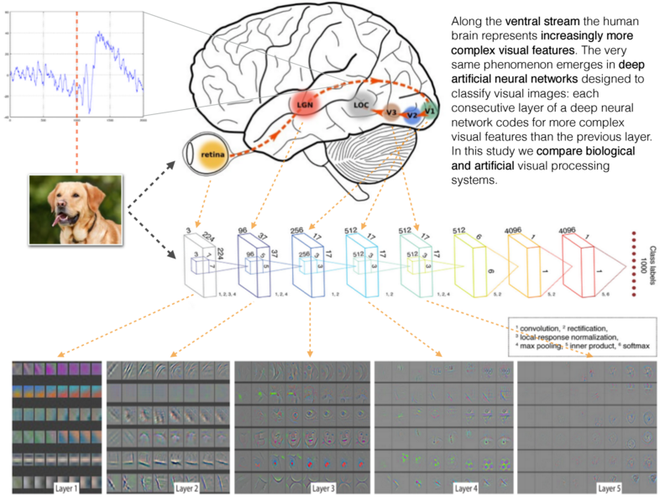

Slide 28
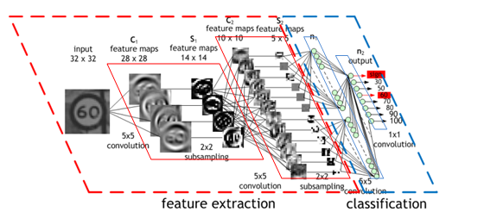
CNN: Example

Slide 29
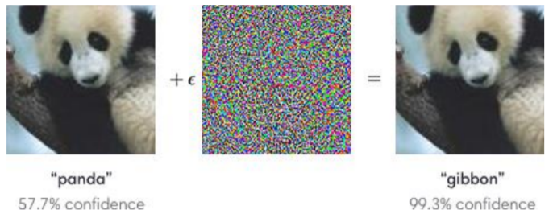
Adversarial Attacks on CNN
Produce noise by using
Gradient Descent towards Gibbon
We need to know the CNN Model
Defense: train with adversarial examples to improve robustness

Slide 30
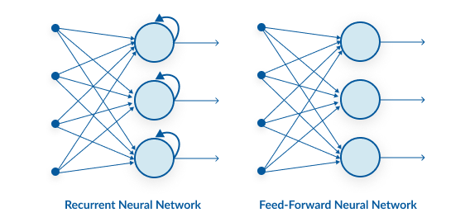
Recurrent Neural Networks

Slide 31
Recurrent Neural Networks
Original
RNN
Network
Image →
Sequence of
Words
Sequence of
Words →
Summary
Machine Translation
Video Classification
on frame level

Slide 32
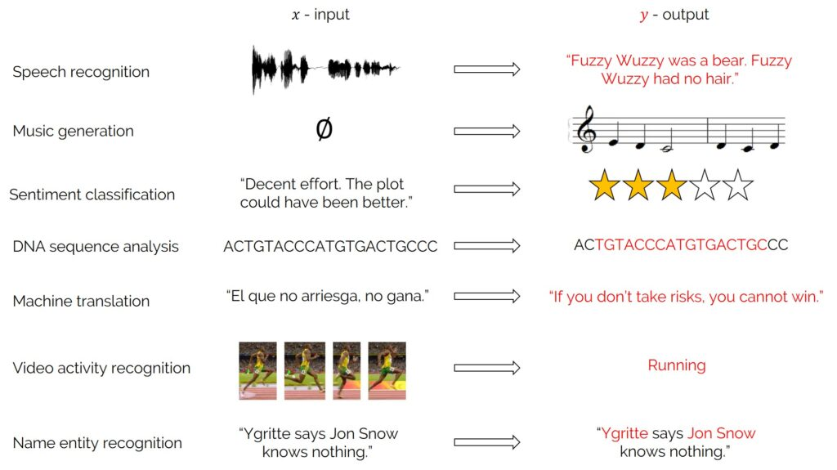
Recurrent Neural Networks
Used for sequence data:

Slide 33
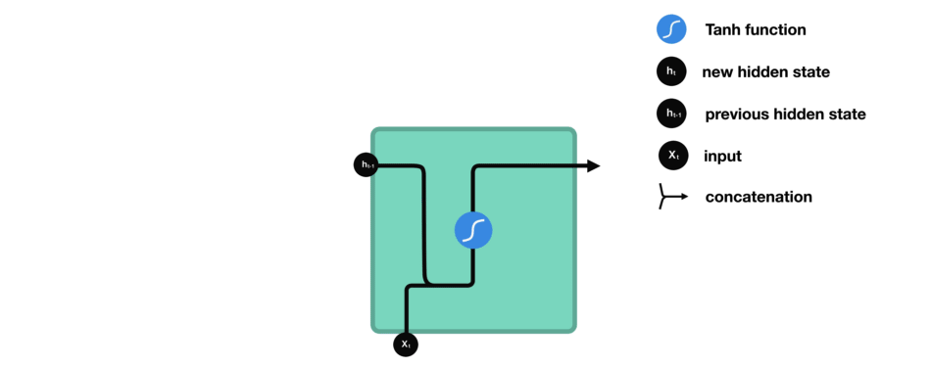
Recurrent Neural Networks: Intuition
Output
Hidden State
Hidden State
Input

Slide 34
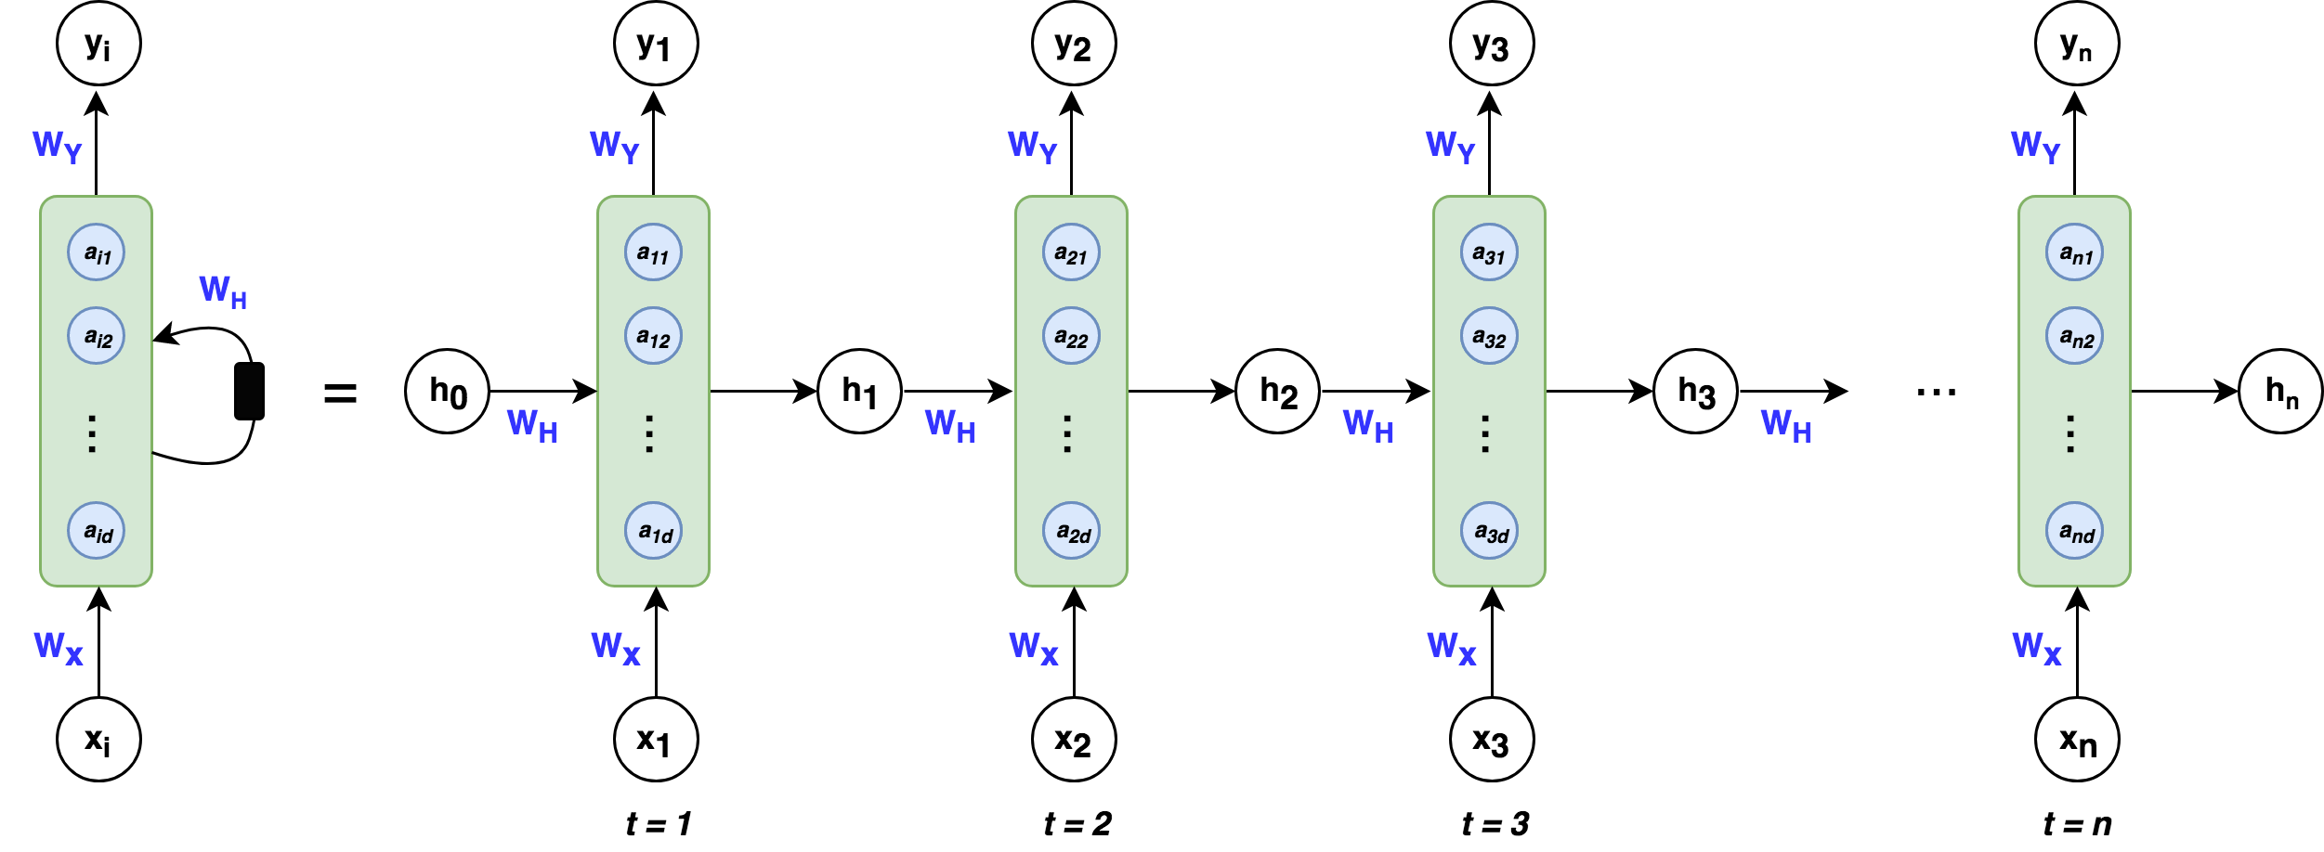
Recurrent Neural Networks
State is saved in hidden vector h → last step is preserved
→ no long-term dependencies
Need to be
learned
Random/Zero
initialization

Slide 35
RNN: Example

Slide 36
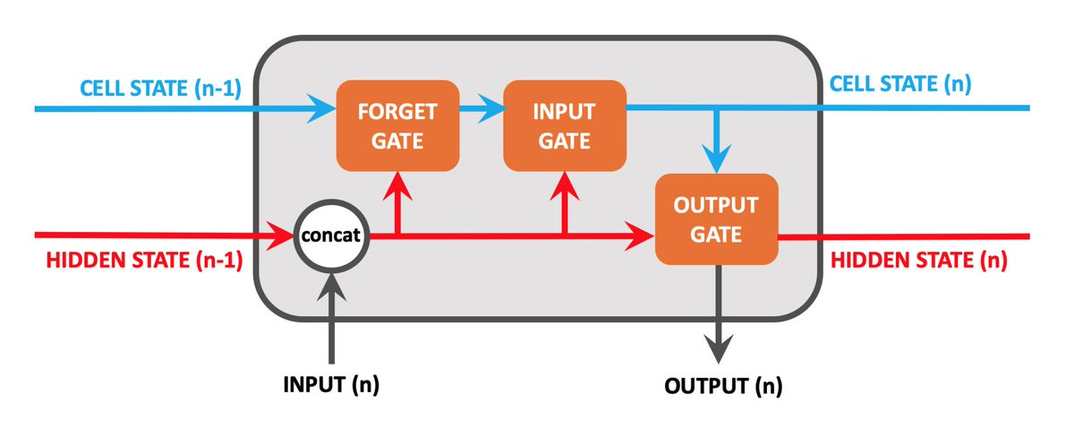
RNN 2.0: Long short-term Memory (LSTM)
Hidden State: holds previous information (Short-term memory)
Cell State: memory of the network (Long-term memory)
What should be forget in cell state
How much new data should be taken
How much does memory affect output

Slide 37
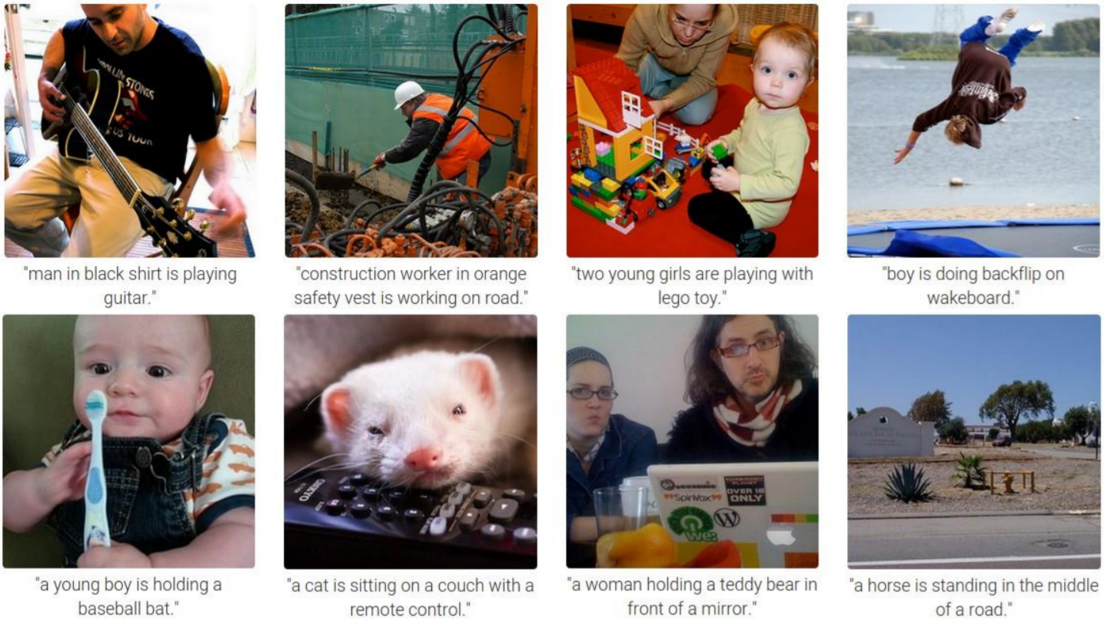
Difficult to train!

Slide 38
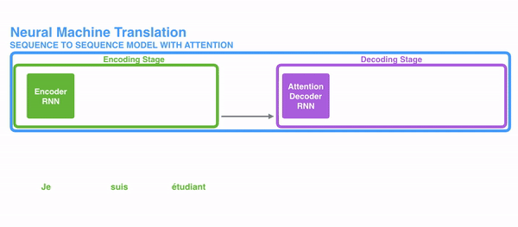
Transformer
RNN: the longer the dependencies the worse
Especially useful in Natural Language Processing and Sequential Data
No sequential processing

Slide 39
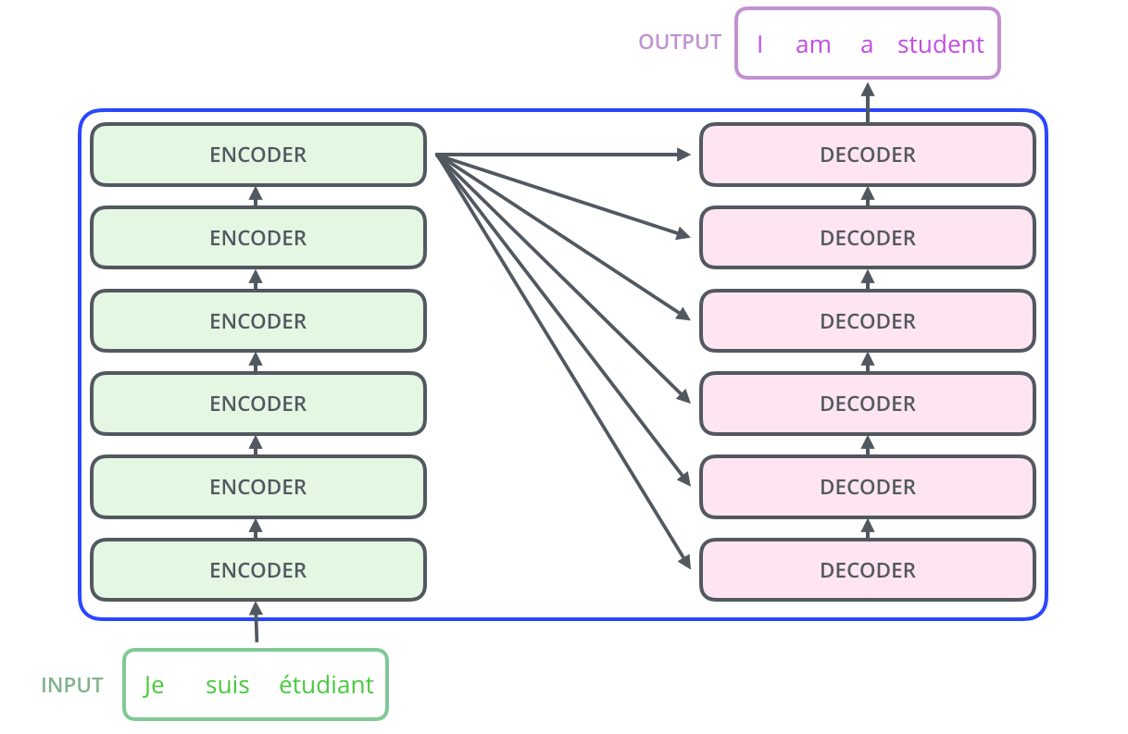
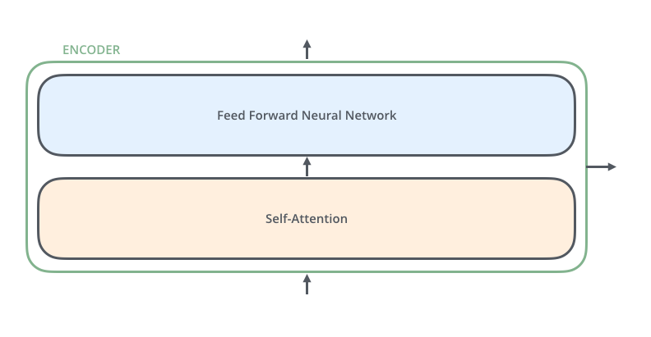
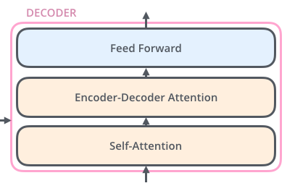
Transformer: Structure

Slide 40
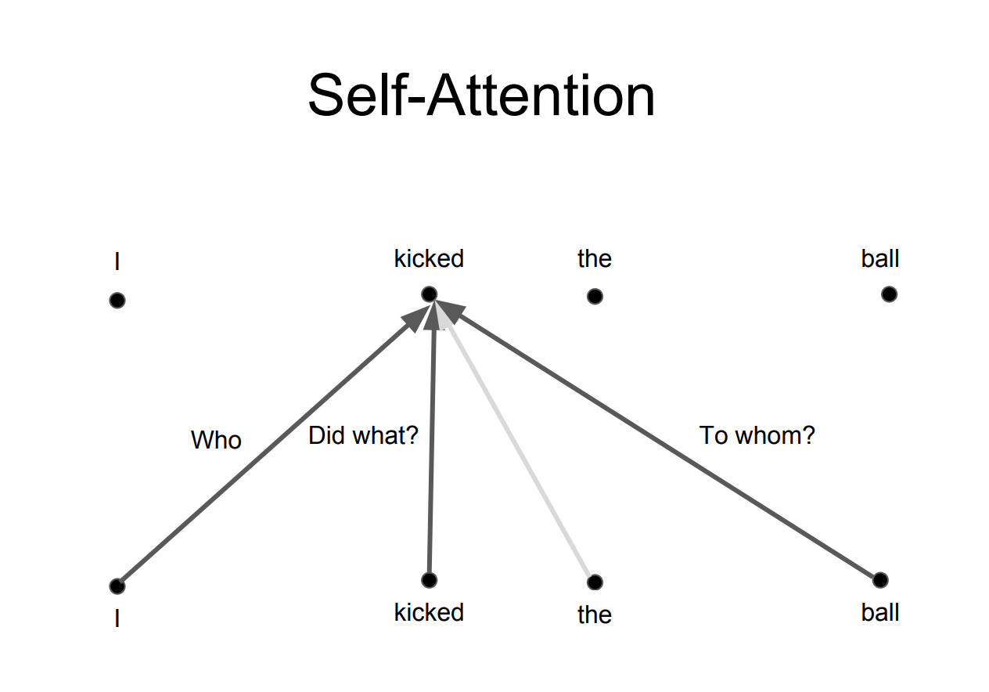
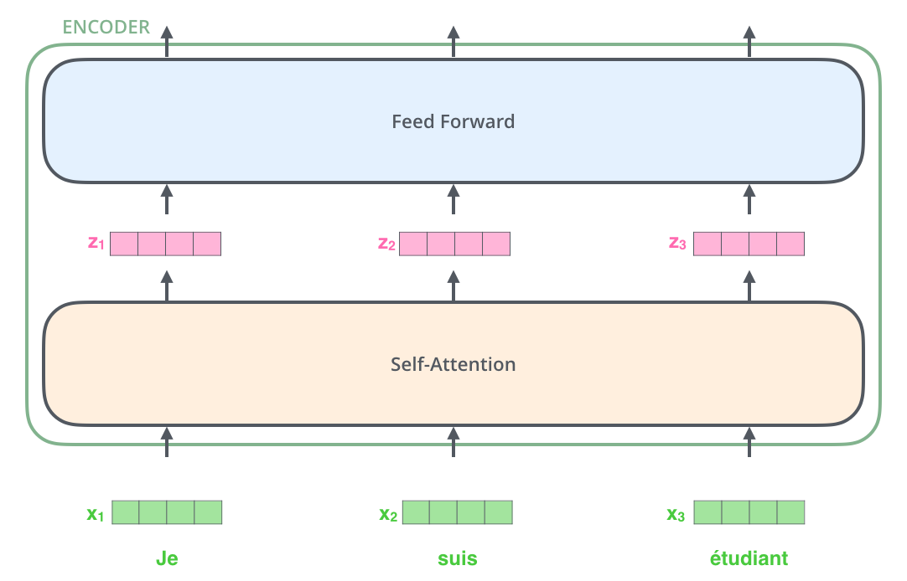
Transformer: all about Attention
Vanilla Attention: combination of previous hidden states
Self-Attention: combination of previous and future hidden states
How much attention should I give word x to word y?

Slide 41
Transformer: all about Attention

Slide 42
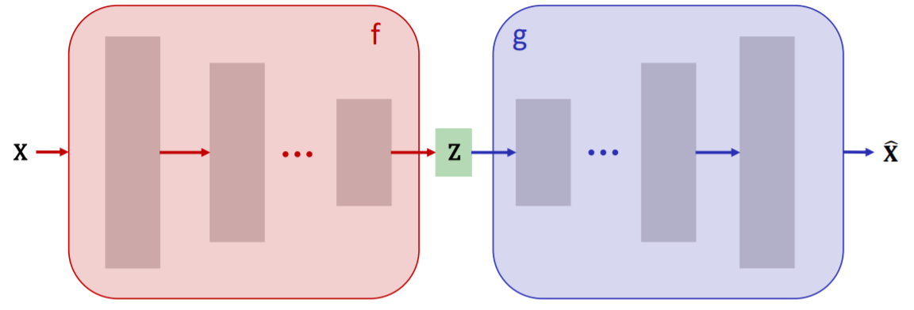
Autoencoder Networks
Generative Model: can generate data from randomized input
Training:

Slide 43
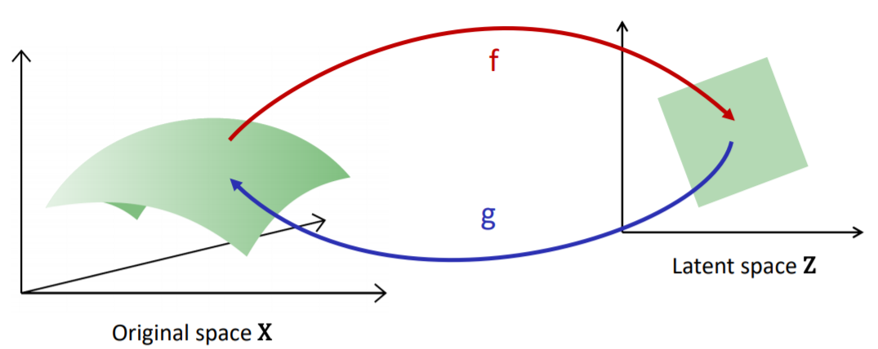
Autoencoder Networks
Encoder
Decoder
Smaller Space

Slide 44
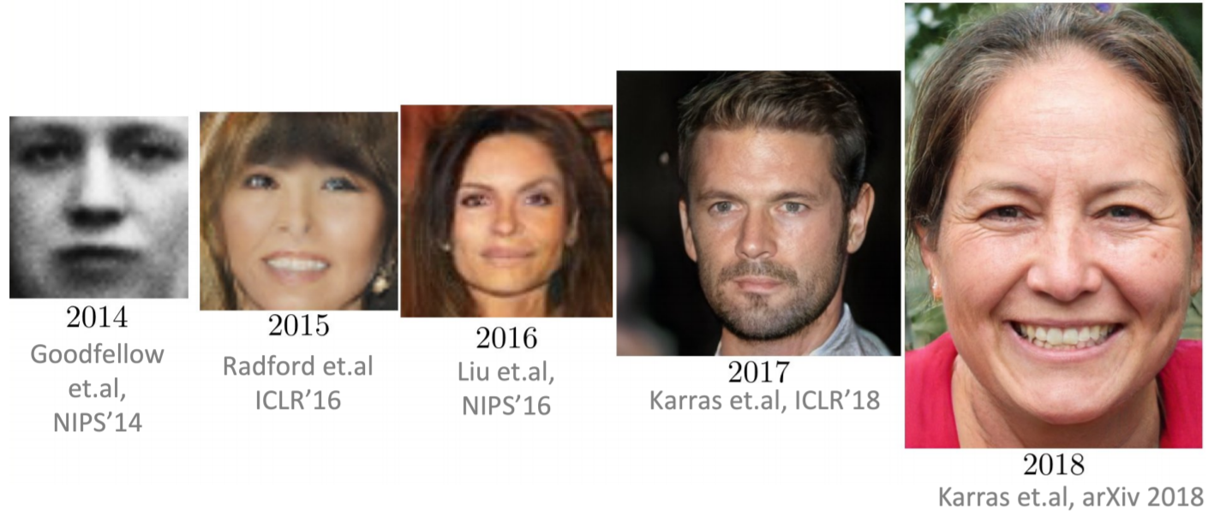
Autoencoder Networks: Example

Slide 45
Deep Learning Frameworks

Slide 46
g
Google
Facebook

Slide 47
For research: mostly used in Python

Slide 48
Industrial Application
Research Application

Slide 49
Static Computational Graph
Lazy Evaluation (faster)
Dynamic Computational Graph
Useful for variable length RNN Input

Slide 51
Discussion Starters
Can adversarial examples for CNN be dangerous (e.g. Cars)?
What is the better approach, supervised/unsupervised learning?
Could there be a deep neural network that can do everything?
Have we already achieved everything in terms of machine learning?

Slide 52
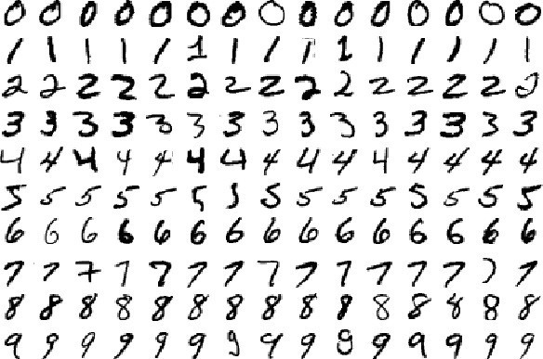
Backup: MNIST Dataset
CNN Benchmark
60‘000 digits training
10‘000 digits testing
Achieved „near-human performance“
In 2018 0.18% error!

Slide 53
Sources
https://towardsdatascience.com/transformers-141e32e69591
https://www.slideserve.com/emele/neural-networks
https://towardsdatascience.com/advanced-topics-in-deep-convolutional-neural-networks-71ef1190522d
https://vinodsblog.com/2019/01/07/deep-learning-introduction-to-recurrent-neural-networks/
https://www.edureka.co/blog/keras-vs-tensorflow-vs-pytorch/
https://www.educba.com/keras-vs-tensorflow-vs-pytorch/
https://www.kaggle.com/residentmario/transformer-architecture-self-attention
https://towardsdatascience.com/illustrated-guide-to-lstms-and-gru-s-a-step-by-step-explanation-44e9eb85bf21
https://stats.stackexchange.com/questions/222584/difference-between-feedback-rnn-and-lstm-gru
https://openreview.net/forum?id=B1g5sA4twr
https://www.kdnuggets.com/2020/04/double-descent-hypothesis-bigger-models-more-data-hurt-performance.html
https://www.saedsayad.com/gradient_descent.htm
https://towardsdatascience.com/a-comprehensive-guide-to-convolutional-neural-networks-the-eli5-way-3bd2b1164a53
Machine Perception Lecture by O. Hilliges
Advanced Machine Learning by J. Buhmann

