Slide 1
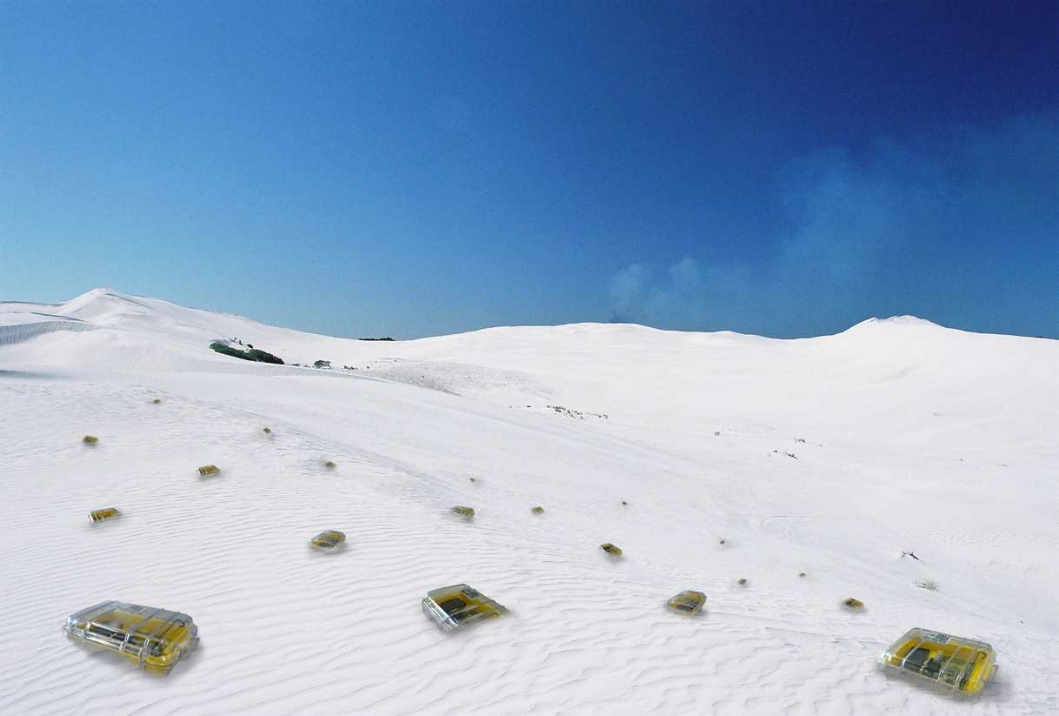

MAC Theory
Chapter 7
TexPoint fonts used in EMF.
Read the TexPoint manual before you delete this box.: AAAAAAAAA

Slide 2
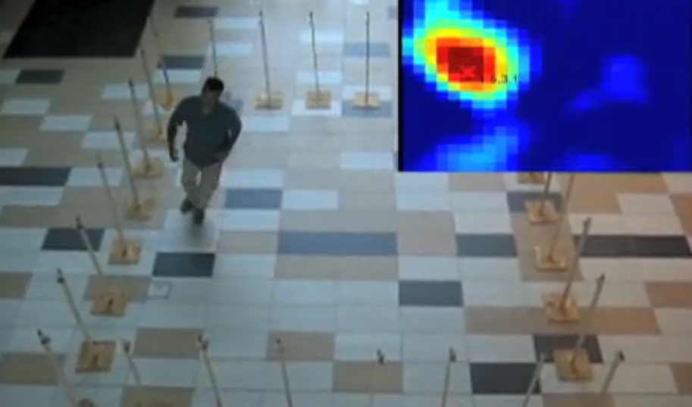

Seeing Through Walls!
[Wilson, Patwari, U. Utah]
Schoolboy‘s dream, now “reality” thank to sensor networks...

Slide 3
Rating
Area maturity
Practical importance
Theory appeal
First steps Text book
No apps Mission critical
Boooooooring Exciting

Slide 4
Overview
Understanding Aloha
Unknown Neighborhood
The Broadcast Problem

Slide 5
The best MAC protocol?!?
Energy-efficiency vs. throughput vs. delay
Worst-case guarantees vs. best-effort
Centralized/offline vs. distributed/online
So, clearly, there cannot be a best MAC protocol!
… but we don’t like such a statement
  We study some ideas in more detail…

Slide 6
Slotted Aloha
We assume that the stations
are perfectly synchronous
In each time slot each station
transmits with probability p.
In Slotted Aloha, a station can transmit successfully with probability at least 1/e, or about 36% of the time.

Slide 7
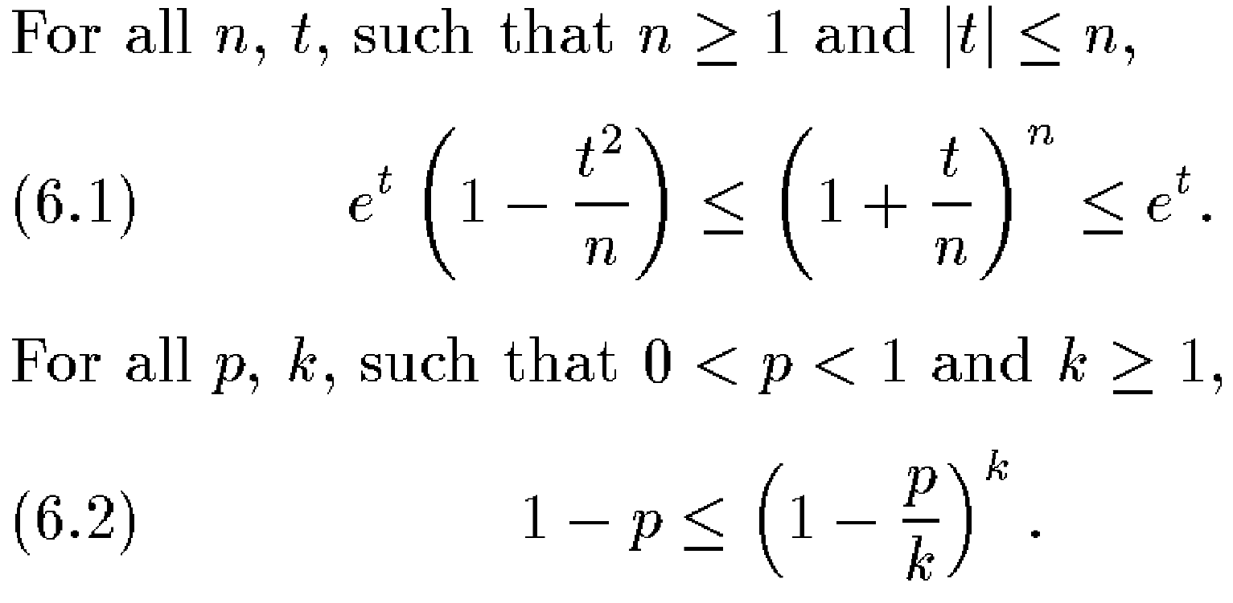
Some formula favorites („Chernoff-type“ inequalities)
How often do you need to repeat an experiment that succeeds
with probability p, until one actually succeeds? In expectation 1/p times. Insights like this have been formulated in various ways,
for instance:

Slide 8
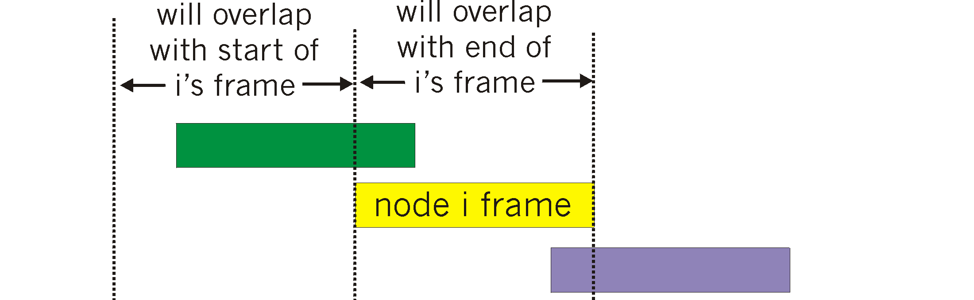
Unslotted (Pure) Aloha
Unslotted Aloha: simpler, no (potentially costly!) synchronization
However, collision probability increases. Why?
To simplify the analysis, we assume that
  All packets have equal size.
  We still have tiny time slots,
  that is, each packet takes t
  slots to complete, with t → 1.
  In order to get comparable
  numbers to the slotted case,
  assume that a node starts a
  transmission with probability p/t.
  Since a transmission can interfere with 2t-1 starting points of n-1 other nodes, we have:

Slide 9
Unslotted Aloha (2)
What p maximizes this probability?
Hence:
Plugging p back in, we have a successful transmission
of any of the n stations in time t of:
This is the often-quoted factor-2-handicap of unslotted vs. slotted.
In Slotted Aloha, a station can transmit successfully with probability at least 1/e, or about 36% of the time.
!

Slide 10
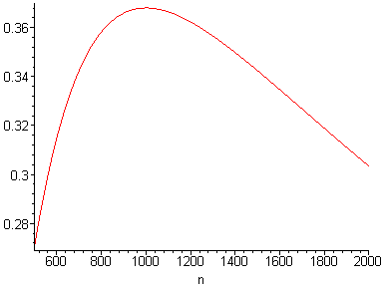
Aloha Robustness
We have seen that round robin has a problem when a new station joins. In contrast, Aloha is quite robust.
Example: If the actual
number of stations is
twice as high as expected,
there is still a successful
transmission with
probability 30%. If it is only
half, 27% of the slots are
used successfully. So nodes
just need a good estimate
of the number of nodes in
their neighborhood.

Slide 11
Adaptive Slotted Aloha
Idea: Change the access probability with the number of stations
How can we estimate the current number of stations in the system?
Assume that stations can distinguish whether 0, 1, or more than 1 stations transmit in a time slot.
Idea:
  If you see that nobody transmits, increase p.
  If you see that more than one transmits, decrease p.
Model:
  Number of stations that want to transmit: n.
  Estimate of n:
  Transmission probability: p = 1/
  Arrival rate (new stations that want to transmit): λ (with λ < 1/e).

Slide 12
Adaptive Slotted Aloha (2)
We have to show that the system stabilizes. Sketch:
n –

Slide 13
Adaptive Slotted Aloha Q&A
Q: What if we do not know λ, or λ is changing?
A: Use λ = 1/e, and the algorithm still works.
Q: How do newly arriving stations know ?
A: We send with each transmission; new stations do not send before successfully receiving the first transmission.
Q: What if stations are not synchronized?
A: Aloha (non-slotted) is twice as bad.
Q: Can stations really listen to all time slots (save energy by turning off)? Can stations really distinguish between 0, 1, and ¸2 sender?
A: Maybe. One can use systems that only rely on acknowledgements.

Slide 14
Unknown Neighborhood?
We have n nodes, all direct neighbors (no multi-hop).
  However, the value n is not known (a.k.a. “uniform” model)
Time is slotted (as in Slotted Aloha).
  Synchronous start: All nodes start the protocol at the very same instant.
In each time slot, a node can either transmit or receive.
  If exactly one node transmits, all other nodes will receive that message.
  Without collision detection: More than one transmitting node cannot be distinguished from nobody transmitting. There is just no message that can be received correctly (because of interference).
  Transmitters cannot know whether they transmitted alone or not.
What would we want to achieve?
  Lots of throughput? Fairness between transmitters?
  Get an exact count of n? Get an estimate of n?
  How long does it take until a single node can transmit alone!

Slide 15
Uniform, Sync-Start, Without Collision Detection
Can a deterministic algorithm work?
  If nodes just execute the very same algorithm, even two nodes cannot solve the problem because they would always do exactly the same all the time (and none of them would ever receive the transmission of the other).
  In other words, they need to execute some algorithm that heavily depends on their node ID. Such an algorithm must work for all combinations of possible node ID’s. Although this is certainly possible, it’s quite difficult. Randomized algorithms are much easier.
Just transmit with probability p = 1/n.
  Simple; finishes in expected e (2.71) rounds.
  But not uniform!

Slide 16
Uniform, Sync-Start, Without Collision Detection (2)
Alternative: In slot k, send with p = 1/k.
  This is uniform (there is no n in the algorithm).
  But it is also too slow, as it takes n rounds to get to Aloha.
Better alternative: Send with probability p = 2^{-k} for 2ck slots, k = 1,2, …
  At first, p is too high, but soon enough 2^{k} ¼ n.
  If we assume (for simplicity) that 2^{k} = n, then the probability that
  any single node transmits alone is n¢2^{-k}¢(1-2^{-k})^{n-1} ¸ 1/e (exactly Aloha!)
  Since each phase has 2ck slots, the probability that one of them is successful is 1-(1-1/e)^{2ck} ¸ 1-2^{-ck} = 1-1/n^{c}.
  This last term is known as „with high probability“. Hence, with high probability we are successful after O(log²n) steps.
How does the successful sender know that it‘s done?

Slide 17
Uniform, Asynchronous Start, Without Collision Detection
Assume that nodes may wake up in an arbitrary (worst-case) way.
Also assume that nodes do not have IDs
  In other words, all nodes must perform the same way, until one node can transmit alone (at which point the others may learn and adapt).
How long does it take until the first node can transmit alone?
  If nodes that are awake never transmit (just listen), we will never finish.
  There must be a first time slot where a node tries to transmit, with probability p. Remember that all nodes perform the same protocol!
  We have the uniform model, hence p is a constant, independent of n.
  We trick the algorithm by waking up c/p¢log n nodes in each step.
  Using our Chernoff bounds, with high probability at least two newly woken nodes will transmit in each slot. We always have collisions!
Hence, in this model any algorithm will need at least Ω(n / log n) time!
[Jurdzinski, Stachowiak, 2005]

Slide 18
Uniform, Sync-Start, With Collision Detection
In each time slot, a node can either transmit or receive.
  If exactly one node transmits, all other nodes will receive that message.
  With collision detection: More than one transmitting node can be distinguished from nobody transmitting.
    There are models where one can estimate the number of transmissions
    Here we just assume to differentiate between 0, 1, or ¸2 transmissions.
    Transmitters themselves do not know anything about other transmissions.
Simple Algorithm:
  repeat
  repeat transmit; throw coin until coin shows head;
  listen
  until somebody was transmitting when listening;
After O(log n) steps, only a constant number remains in the pool.
After O(log n) more steps, only one remains (with high probability)!

Slide 19
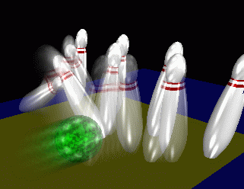
Uniform, Sync-Start, With Collision Detection [Willard 1986]
The power of collision detection
  For instance, a transmitter s can figure out if it transmitted alone. If s was alone (case 1), all but s should transmit in the next time slot; if s was not alone (0 or ¸2), all should remain silent in the next time slot. Using this trick we may elect a “leader”.
  Similarly all can figure out if there was at least one sender.
Also, we can get a rough estimate of the number of nodes quickly
  Just reduce the sending probability … … aggressively
  Indeed, in round k, send with probability , for k ¸ 0.
  This becomes interesting if it is about equal to 1/n, that is k ¼ √loglog n.
  Now we check all
  This costs loglog n time, approximating n well
  After this phase only logloglog n nodes survive.
  With so few nodes, loglog n tests are enough.
  The total time is O(loglog n) in expectation.

Slide 20
The best multi-hop MAC protocol?!?
As in single-hop, there cannot be a best MAC protocol.
  Energy-efficiency vs. throughput vs. delay
  Worst-case guarantees vs. best-effort
  Centralized/offline vs. distributed/online
Multi-hop challenges?
  Random topology vs. worst-case graph vs. worst-case UDG vs. …
  Network layer: local broadcast vs. all-to-all vs. broadcast/echo
  Transport layer: continuous data vs. bursts vs. …
We need a simple multi-hop case study
  The “Broadcasting” Problem

Slide 21
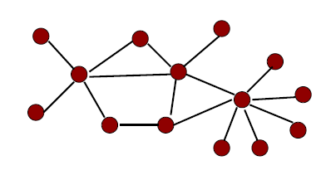
Model
Network is an undirected graph (arbitrary, not UDG)
  Nodes do not know topology of graph
Synchronous rounds
  Again, nodes can either transmit or receive
Message is received if exactly one neighbor transmits
  Without collision detection: That is, a node cannot distinguish whether
  0 or 2 or more neighbors transmit
We study the broadcasting problem
  sort of multi-hop MAC layer, not quite
  Initially only source has message
  finally every node has message
How long does this take?!?

Slide 22
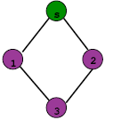
Deterministic Anonymous Algorithms
If nodes are anonymous (they have no node IDs), then one cannot solve the broadcast problem
  For the graph on the right nodes 1 and 2 always have the same input, and hence always do the same thing, and hence node 3 can never receive the message.
So, again, the nodes need IDs, or we need a randomized algorithm. We first study the deterministic case!

Slide 23
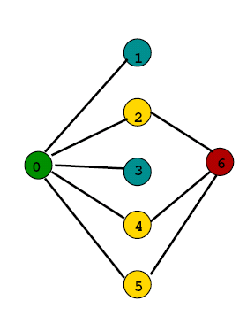
Deterministic algorithms (not anonymous)
Consider the following network family:
n+2 nodes, 3 layers
  First layer: source node (green)
  Last layer: final node (red)
  Middle layer: all other nodes (n)
  Source connected to all nodes in middle layer
  Middle layer consists of golden and blue nodes
  Golden nodes connect to red node,
  blue nodes don’t.
In one single step all middle nodes know message.
And…? The problem is that we don’t know the golden nodes!

Slide 24
How to choose golden nodes?
Task:
  Given deterministic algorithm, i.e., we have sets M_{i} of nodes that transmit concurrently, first set M₁, then M₂, etc.
  Choose golden and blue nodes, such that no set M_{i} contains a single golden node.
Construction of golden set
  We start with golden set S being all middle nodes
  While ∃ M_{i} such that |M_{i} ∩ S| = 1 do S:= S\ {M_{i} ∩ S}
Any deterministic algorithm needs at least n rounds
  In every iteration a golden node intersecting with M_{i} is removed from S; set M_{i} does not have to be considered again afterwards.
  Thus after n-1 rounds we still have one golden node left and all sets M_{i} do not contain exactly one golden node.

Slide 25
Improvement through randomization?
It does not help if in each step a random node is chosen, because a single golden node is still only found after about n/2 steps. So we need something smarter…
Randomly select n^{i/k} nodes, for i = 0, 1,…,k-1 also chosen randomly.
  Assume that there are about n^{s/k} golden nodes.
  Then the chance to randomly select a single golden node is about
  If we are lucky and k ¼ i+s this simplifies to
  If we choose k = log n and do the computation correctly, we need polylogarithmic trials to find a single golden node (c.f. slide 7/16).
Positions for golden node
Probability for golden node
All others are not golden

Slide 26
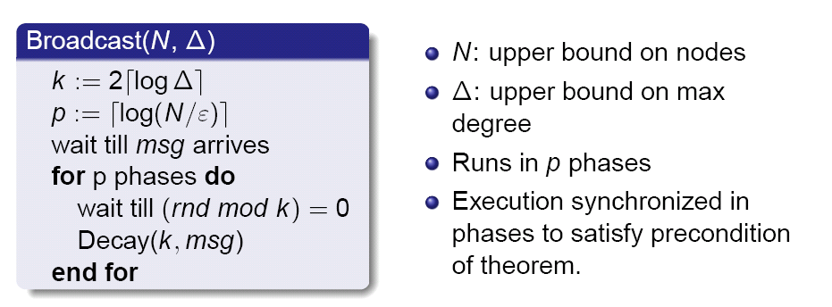
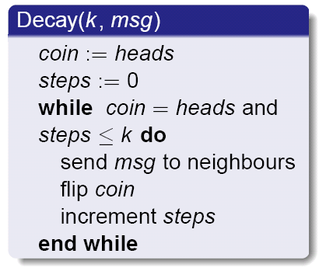
Randomized protocol for arbitrary graphs
O(D·log²n)
N: upper bound on node number
¢: upper bound on max degree
²: Failure probability, think ² = 1/N
N,¢,² are globally known
D: diameter of graph
Algorithm runs in synchronous phases, nodes always transmit slot number (“rnd”) in every message; source sends message in first slot.
(Note that the Decay algorithm is pretty similar to some of our single-hop algorithms.)

Slide 27
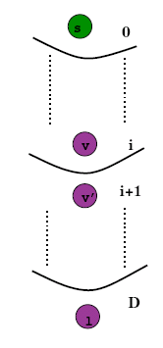
Proof
During one execution of Decay a node can successfully receive a message with probability p ≥ 1/(2e)
Iterating Decay c·log n times we get a
high success probability of p ≥ 1-1/n^{c}
Since a single execution of Decay takes
log n steps, all nodes of the next level receive the message after c·log²n steps (again, with high probability).
Having D layers a total of O(D·log²n) rounds is sufficient (with high probability).

Slide 28
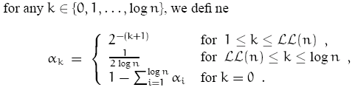
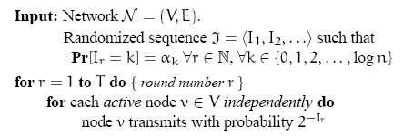
Fastest Broadcast Algorithm [Czumaj, Rytter 2003]
= loglog n
Node that received
message from source
Known lower bound Ω(D·log(n/D) + log²n)
Fastest algorithm matches lower bound. Sketch of one case:

Slide 29
Conclusion
A lot of theoretical research is centered around Aloha-style research, since in the big-Oh world, 36% or 18% throughput is only a constant factor off the optimal, which is considered “negligible”, or “asymptotically optimal”…
In reality, we would often not be happy with an algorithm that finishes the task in O(f(n)) time, if the hidden constant is huge. Not even if the hidden constant is, uh, constant.
What we need is a mix between Aloha, TDMA, and reservation.

