Slide 1
Quorum Systems & Distributed Storage
Computer Systems week 10
Distributed Systems week 4
2021-12-03

Slide 2
Content
Content:
Quorum Systems
Distributed Storage
Assignment 10 quiz
Assignment 9 solutions

Slide 3
Quorum Systems
High-level functionality:
Client selects a free quorum
Locks all nodes of the quorum
Client releases all locks

Slide 4
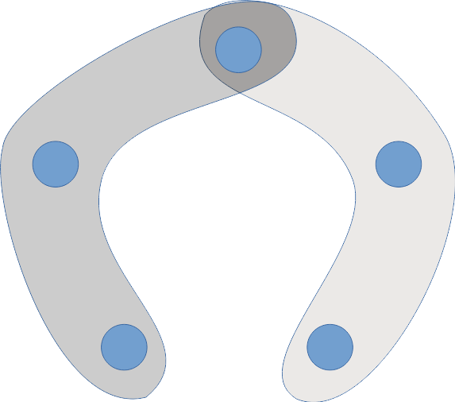
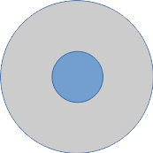
Singleton and majority quorum systems
Singleton
Majority quorum system
(every set of floor(n/2)+1 nodes)

Slide 5
Load and work

Slide 6
Load and Work
An access strategy Z defines the probability P_Z(Q) of accessing a quorum Q \in S such that
Notes:
‹#›

Slide 7
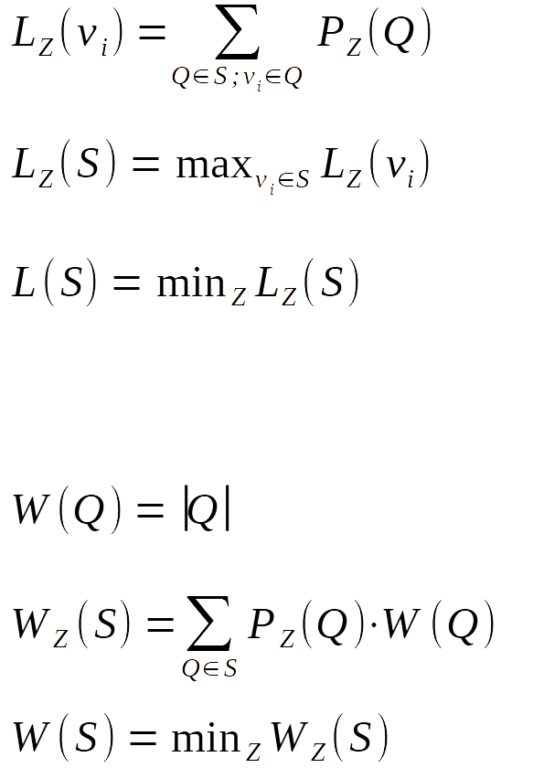
Load and work
Load of access strategy Z on a node v_{i}
Load induced by Z on quorum system S
Load of quorum system S
Work of quorum Q
Work induced by Z on quorum system S
Work of quorum system S
Notes:
‹#›

Slide 8
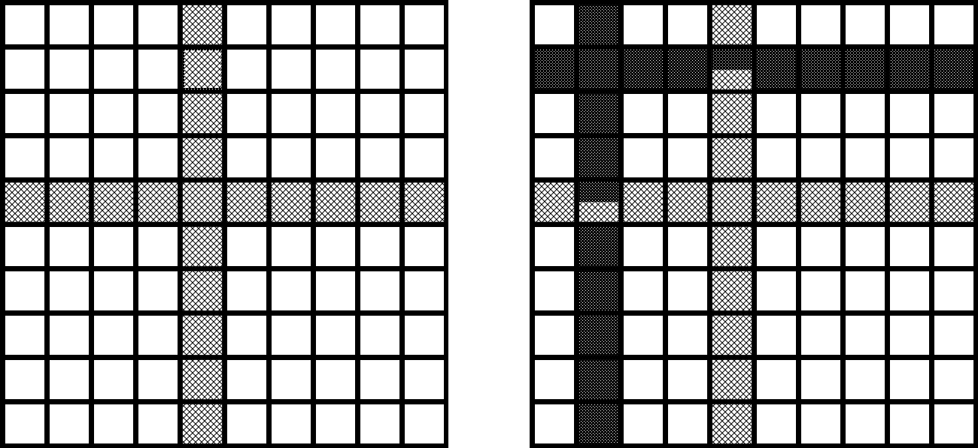
Basic Grid Quorum System
n nodes arranged in a square matrix
Each quorum contains the full row i and the full column i
Notes:
‹#›

Slide 9
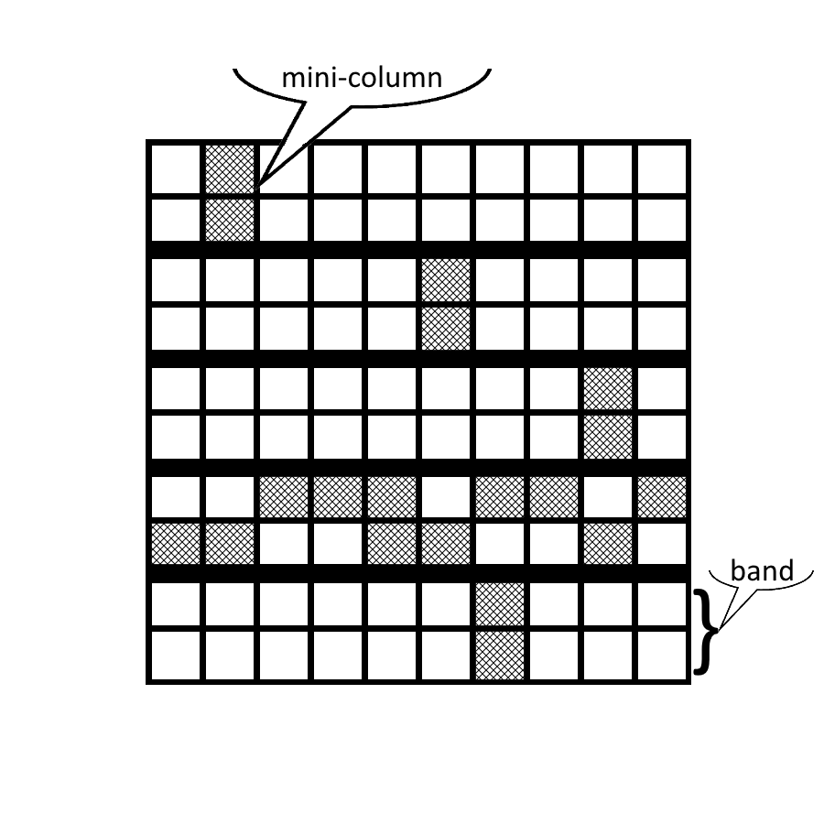
B-Grid Quorum System
n nodes arranged in a rectangular grid with h∙r rows and d columns
Group of r rows is a band, r elements in a column restricted to a band is a mini-column
Each quorum consists of one mini-column in every band and one element from each mini-column of one band
Notes:
‹#›

Slide 10
Distributed storage
Consistent Hashing
Hypercubic Networks
DHT & Churn

Slide 11
1 - Consistent Hashing
How to store many items on many nodes in a “consistent” manner?
=> Use hash functions to transform item and node IDs into values in [0,1)
Item is stored on machine with the closest hash

Slide 12
1 - Consistent Hashing
Some properties of consistent hashing:
Each node stores the same number of items in expectation
Number of hash functions determines degree of duplication
Any single node’s memory consumption is bounded (Fact 21.3, Chernoff bound)
Supports nodes leaving/joining

Slide 13
2 - Hypercubic Networks
How should our distributed storage system look like?
How should the nodes be connected?
How do we find a particular item?
...

Slide 14
2 - Hypercubic Networks
In a classic distributed system one node can have a view of the entire system because nodes rarely leave/join
However, we are considering very large networks with high churn in which it becomes impossible for nodes to have an accurate and updated picture of large parts of the network topology
Thus, we want a system that only relies on every node knowing its small neighborhood
=> What kind of network topology should we use?.
Notes:
Churn: Nodes leaving and joining the network

Slide 15
2 - Hypercubic Networks
Consistent hashing reminder: Where to store items.
Hypercubic networks: Arrange nodes such that they form a virtual network, also called an overlay network.
In general, the overlay network gives us the possibility to “navigate” our distributed storage system, i.e., do routing. This is necessary since each node only has a local view, but we still want to find any item, even if it is not in the neighborhood of the node we are currently querying.

Slide 16
2 - Hypercubic Networks
A good overlay topology should fulfill the following properties (more or less)
Homogeneity: No single point of failure, all nodes are “equal”
Node IDs in [0,1) for consistent hashing
Nodes have small degree, i.e., only relatively few neighbours
Small diameter and easy routing: Any node should be reachable within reasonable time

Slide 17
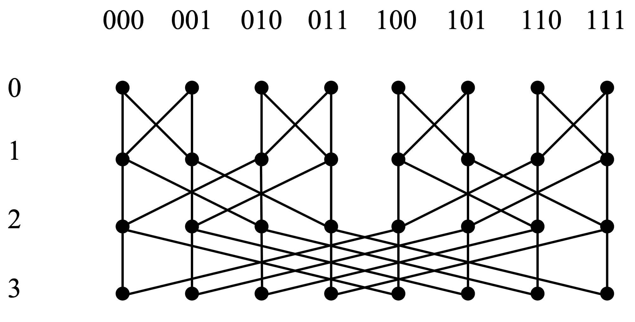
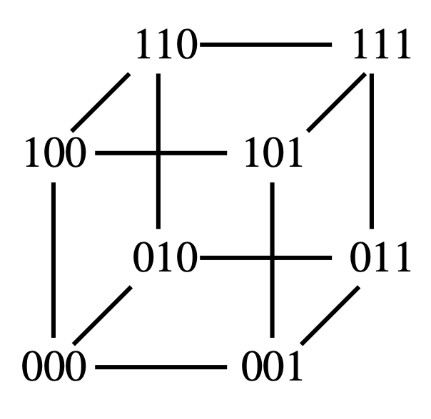
2 - Hypercubic Networks
Different overlay topologies make different trade-offs, for example:
Butterflies: Constant small node degree
Hypercube: More fault tolerant routing, i.e., more short routes between nodes (k! Routes of length k)

Slide 18
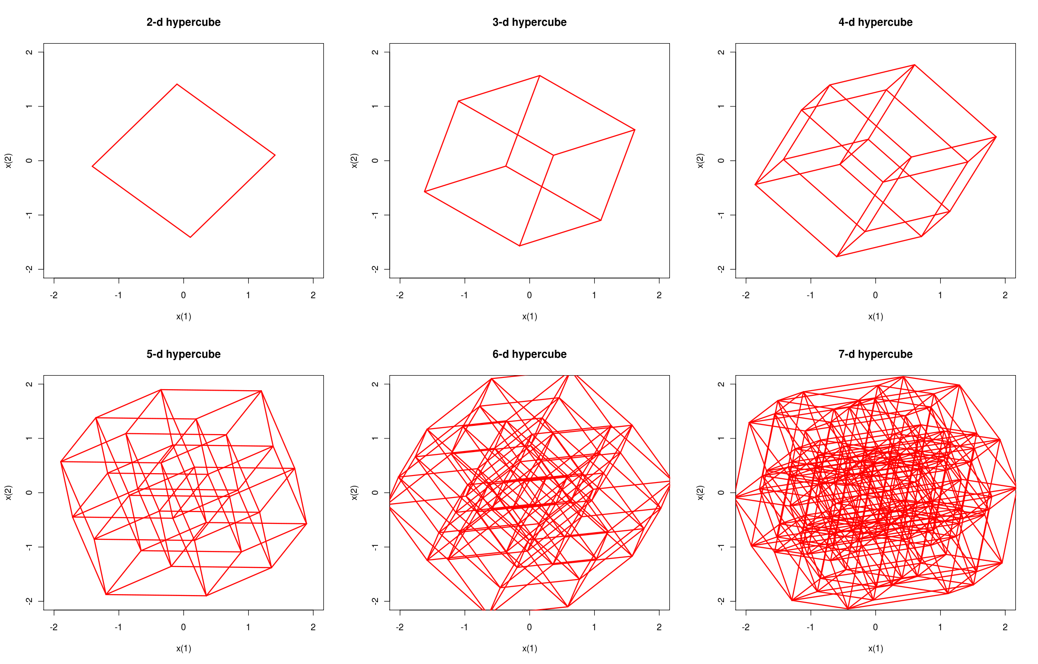
2 - Hypercubic Networks
You will draw some simple hypercubic graphs in the quiz.

Slide 19
3 - DHT & Churn
DHT: Distributed Hash Table
Combines consistent hashing with overlay networks
Supports searching, insertion and (maybe) deletion
For example: Use hypercube with hyper nodes. “Core” nodes store data, “periphery” nodes can move around.

Slide 20
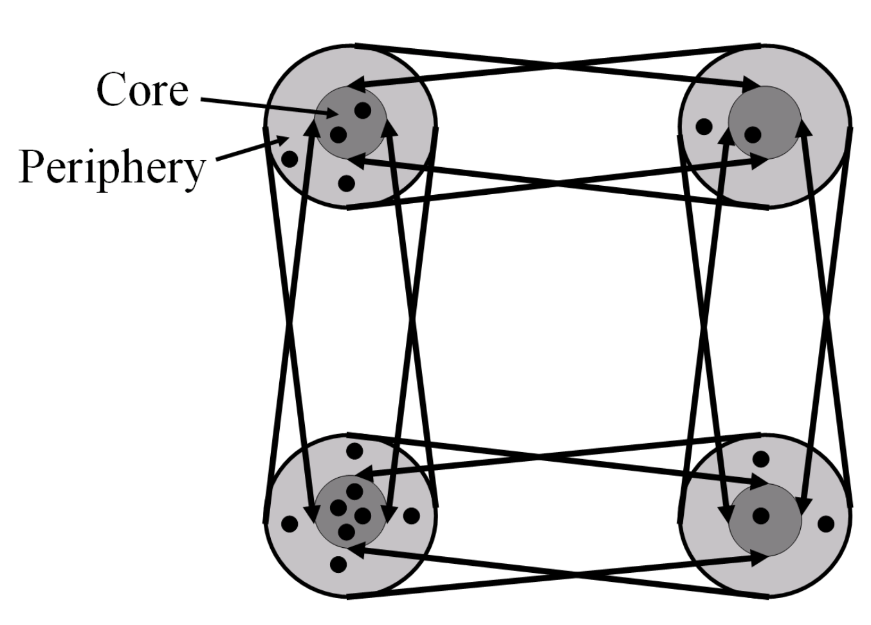
3 - DHT & Churn
Robustness against Churn
Attacker crashes nodes in worst-case manner. Can target weak spots to partition the DHT.
DHT re-distributes nodes to make sure each hyper-node has approximately the same number of nodes => No weak spots

Slide 21
Assignment 10 quiz
1.1 The Resilience of a Quorum System

Slide 22
Assignment 10 quiz
1.1 The Resilience of a Quorum System

Slide 23
Assignment 10 quiz
1.1 The Resilience of a Quorum System

Slide 24
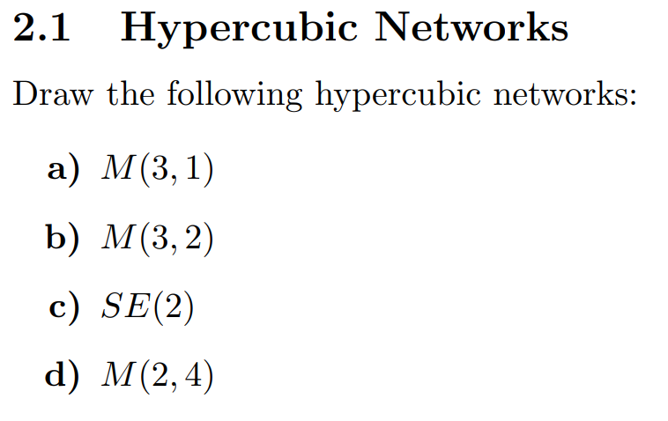
Assignment 10 quiz
2.1 Hypercubic Networks

Slide 25
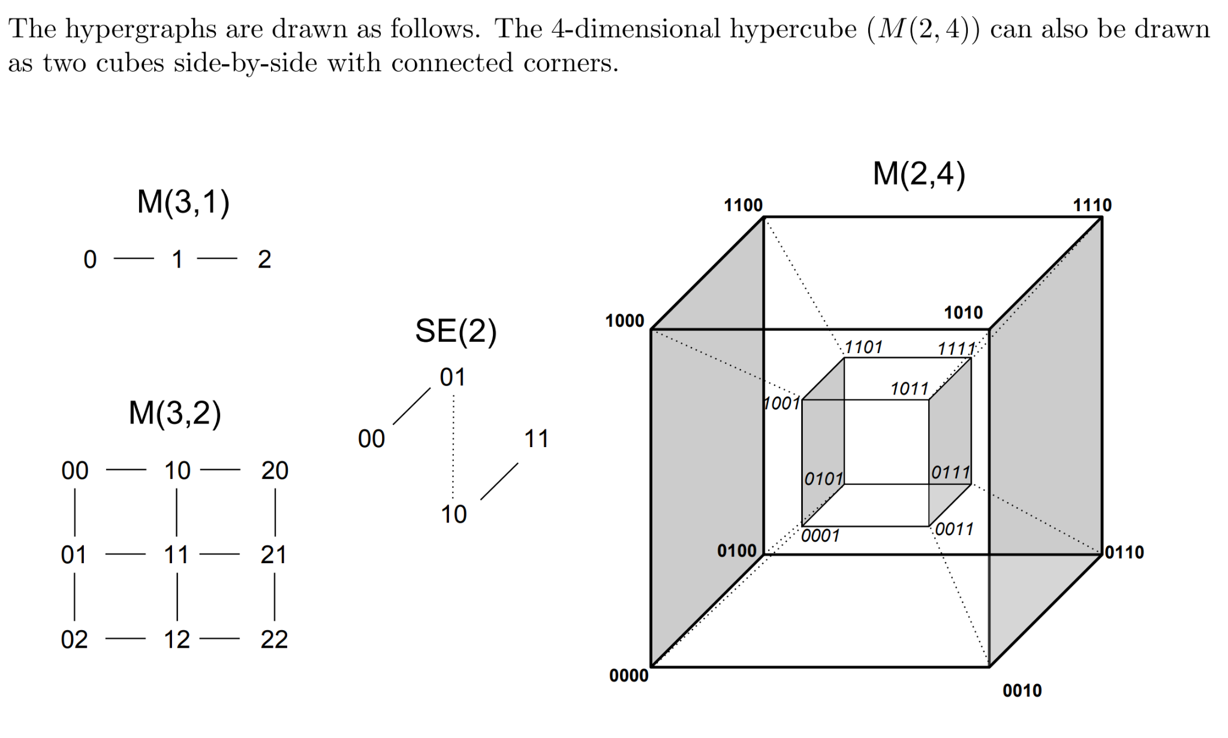
Assignment 10 quiz
2.1 Hypercubic Networks

Slide 26
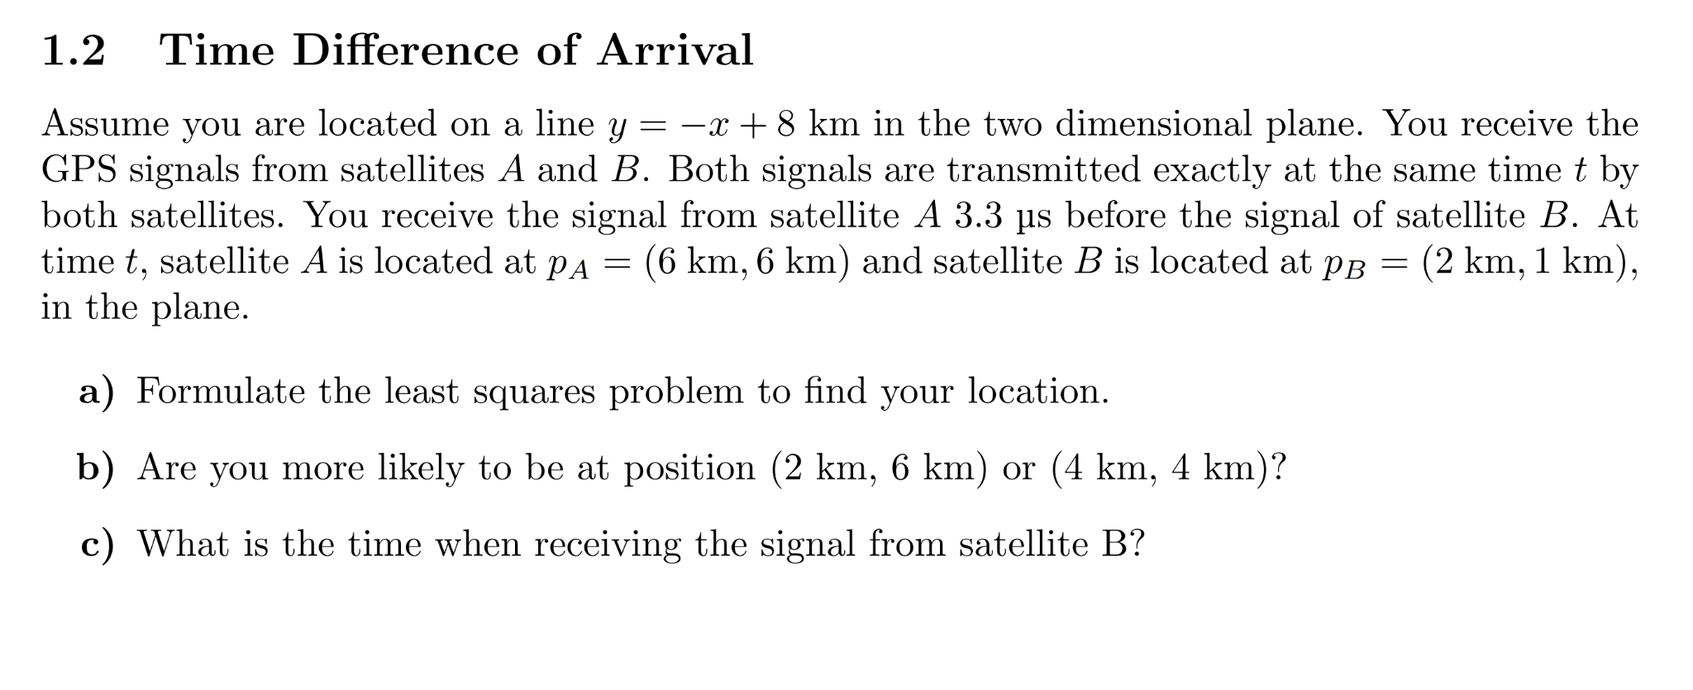
Assignment 9 solutions

Slide 27
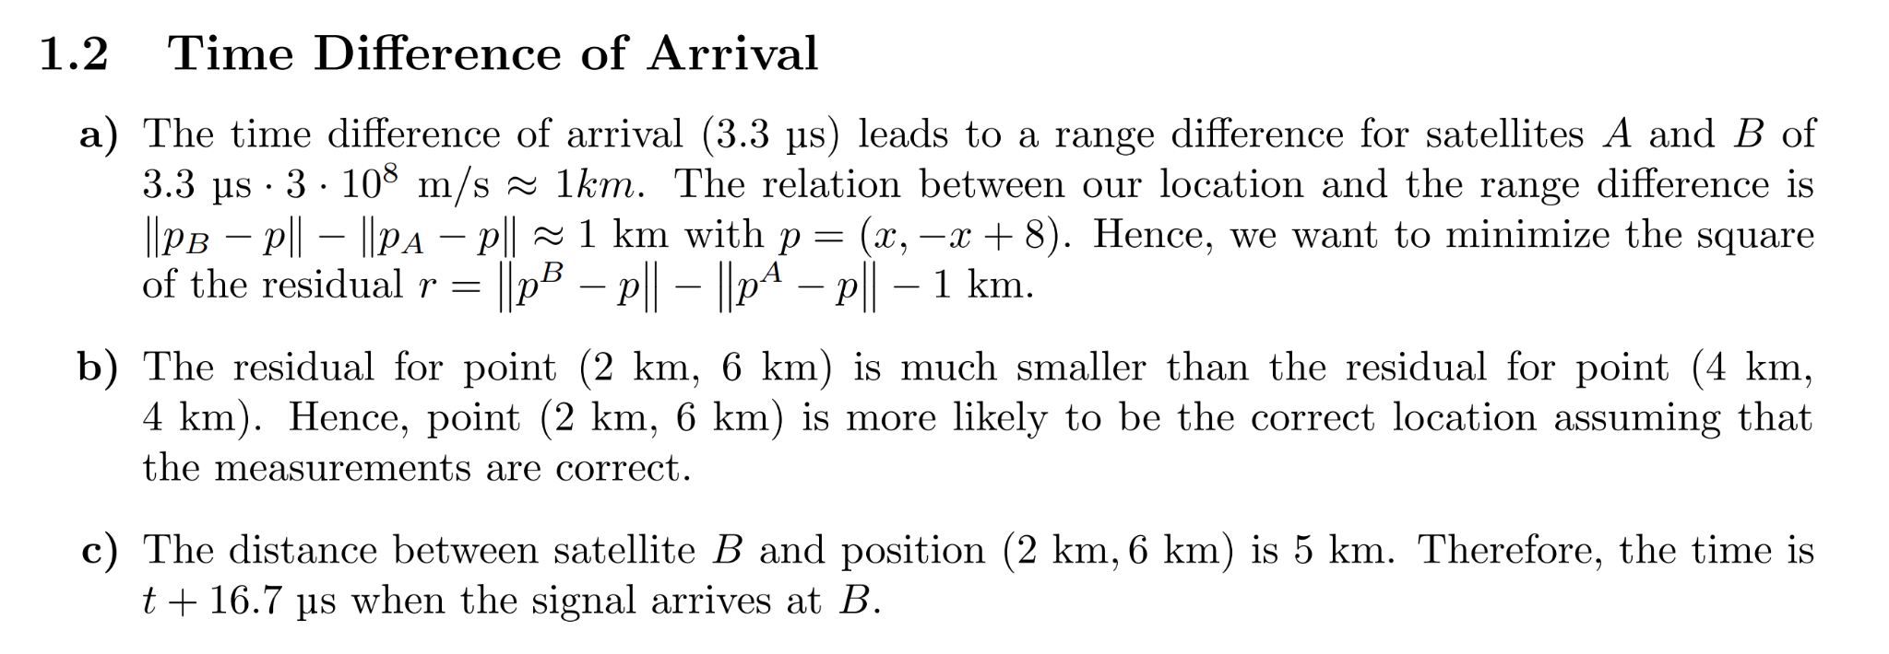
Assignment 9 solutions

Slide 28
Assignment 9 solutions

Slide 29
Assignment 9 solutions

Slide 30
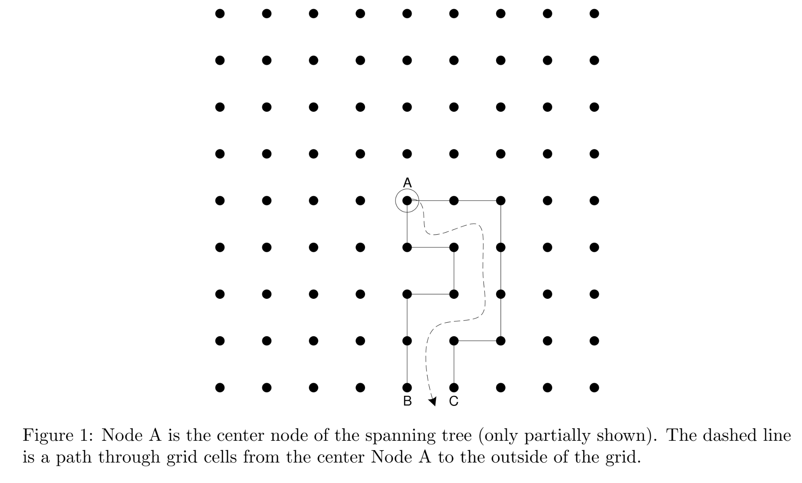
Assignment 9 solutions

Slide 31
Assignment 9 solutions

Slide 32
Assignment 9 solutions
// includes omitted
int main(){
struct timex buf;
buf.modes = 0; // read
adjtimex(&buf);
double posix_time = buf.time.tv_sec;
if (buf.status & STA_NANO){
// nanoseconds used
posix_time += buf.time.tv_usec * 1.0e-9;
} else {
// microseconds used
posix_time += buf.time.tv_usec * 1.0e-6;
}
// Note: This code ignores that we could be "inside" a leap second.
time_t posix_whole_secs = (time_t)buf.time.tv_sec;
struct tm* current_time = gmtime(&posix_whole_secs);
double seconds = fmod(posix_time, 60.0);
float max_error = buf.maxerror * 1.0e-6;
// output code omitted
return EXIT_SUCCESS;
}

Slide 33
Assignment 9 solutions
Notes:
Open master solution to explain, not putting the code onto the slides.

Slide 34
Assignment 9 solutions

